Slide 1
Chapter 9

Slide 2
Learning Objectives
List and contrast the four basic philosophical reasons for sentencing criminals
Contrast indeterminate with determinate sentencing
Explain some of the reasons why sentencing reform has occurred
Identify the arguments for and against the use of victim impact statements during sentencing hearings
Identify the two stages that make up the bifurcated process of death penalty sentencing

Slide 3
LO 1
LO - 1 List and contrast the four basic philosophical reasons for sentencing criminals

Slide 4
Reasons for Sentencing Criminals
Retribution
Punishing a criminal who violates society’s rules
Deterrence
Using punishment as a threat to prevent crime
Incapacitation
Detaining wrongdoers in prison to prevent crime
Reduces opportunities for criminals
Rehabilitation
Providing criminals with resources needed to eliminate criminality from behavioral pattern
Changes the values and personalities of criminals

Slide 5
Components of Restorative Justice
Offender involvement
Victim involvement
Victim-offender interaction
Community involvement
Problem-solving practices

Slide 6
LO 2
LO - 2 Contrast indeterminate with determinate sentencing

Slide 7
Types of Incarceration
Indeterminate sentencing
Prescribes a range of years rather than a definite period of years to be served
Determinate sentencing
Prescribes a fixed period of incarceration that cannot be changed
Good time
Time served in prison is reduced, based on good behaviour, conformity to rules, and other positive behaviour
Truth-in-sentencing laws
Ensures that convicts will serve the terms to which they were initially sentenced

Slide 8
Judicial Dispositions
Capital punishment
Imprisonment
Probation
Fines
Restitution and community service
Apologies

Slide 9
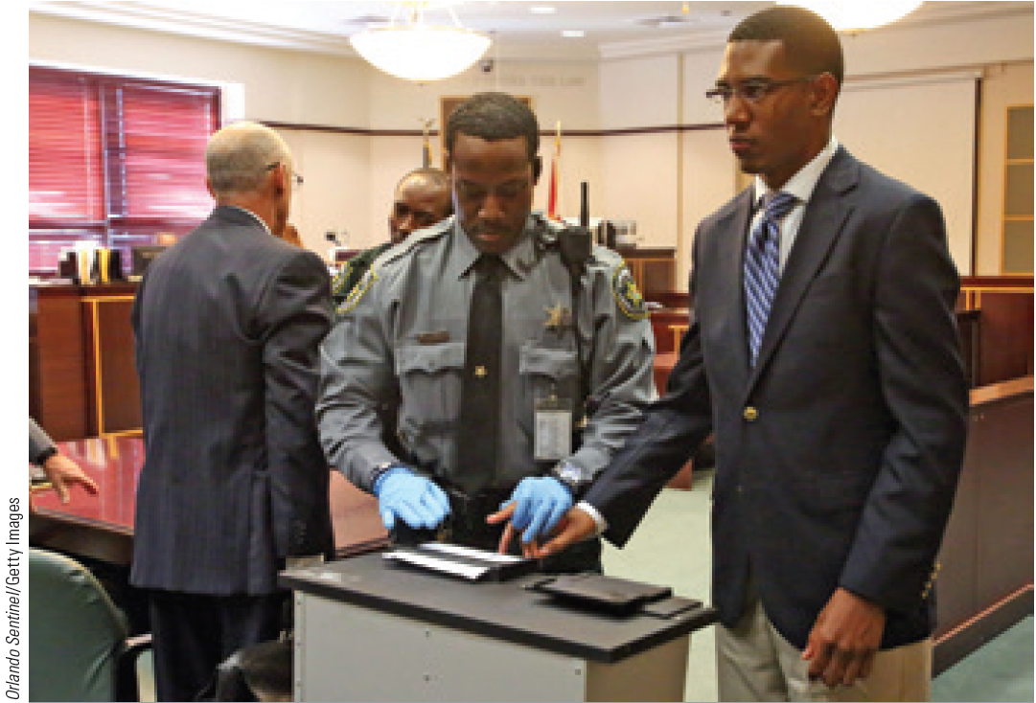
Presentence Investigative Report
Report on an offender’s background that assists a judge in determining the proper sentence
Compiled by a probation officer

Slide 10
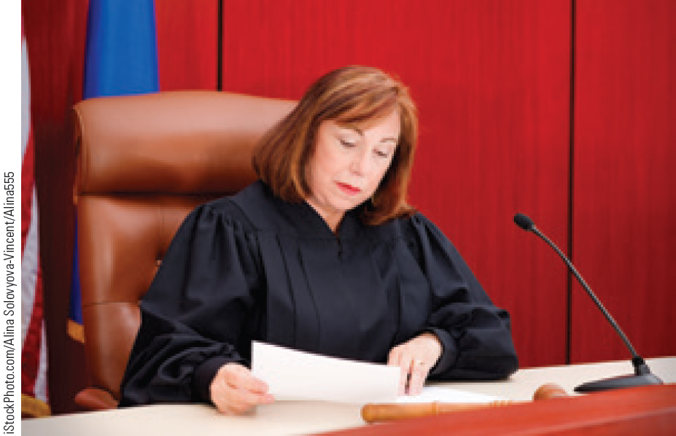
Factors Considered for Sentencing
Seriousness of the crime
Mitigating circumstances
Accompany the commission of a crime that may justify a lighter sentence
Aggravating circumstances
Accompany the commission of a crime that may justify a harsher sentence

Slide 11
LO 3
LO - 3 Explain some of the reasons why sentencing reform has occurred

Slide 12
Sentencing Disparity and Sentencing Discrimination
Sentencing Disparity
Criminals receive:
Similar sentences for different crimes
Different sentences for similar crimes
Mitigating or aggravating circumstances have a disproportionate effect on sentences
Sentencing discrimination: Sentence is influenced by factors not directly related to the crime
Gender, race, or economic standing

Slide 13
Mandatory Sentencing Guidelines
Statutorily determined punishments for specific crimes
State and federal mandatory minimums
Laws related to crimes involving the sale or possession of illegal drugs
Habitual offender laws: Statutes that require lengthy prison sentences for those who are convicted of multiple felonies

Slide 14
Reforming Mandatory Minimums
Expanding judicial discretion
Limiting habitual offender triggers
Repealing or revising mandatory minimum sentences

Slide 15
LO 4
LO - 4 Identify the arguments for and against the use of victim impact statements during sentencing hearings

Slide 16
Victim Impact Evidence
Victim Impact Statement (VIS): Describes how the crime has affected the victim
Provides victims the right to be reasonably heard
Provides victims with psychological satisfaction
Helps judges and juries make informed sentencing decisions

Slide 17
Risks of Victim Evidence
Interjects prejudicial evidence into the sentencing process
May distract judges and juries from the facts of the case
Judges may be compelled to base the punishment on the social value of the victim

Slide 18
LO 5
LO - 5 Identify the two stages that make up the bifurcated process of death penalty sentencing

Slide 19
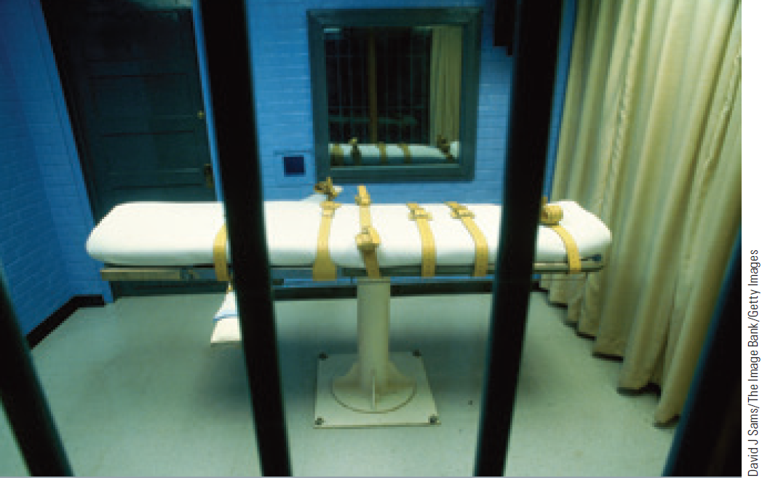
Capital Punishment
Use of death penalty to punish wrongdoers for certain crimes
Methods of execution
Hanging
Lethal gas
Electrocution
Lethal injection

Slide 20
Bifurcated Process
Jury determines guilt or innocence of the defendant for a crime that has, by state statute, been determined to be punishable by death
Jury considers all aggravating and mitigating factors to decide whether the death sentence is in fact warranted
Mitigating circumstances will prevent a guilty defendant from receiving a death penalty

Slide 21
Factors Contributing to the Decline of Capital Punishment
Life-without-parole alternative
Plummeting murder rates
High costs of intensive law enforcement investigations

Slide 22
Careers in Criminal Justice
Mediation specialist
Job description
Act as a third party facilitator between the victim and the offender
Resolve conflicts through a face-to-face discussion of the criminal act
Encourage the increased presence of restorative justice in the criminal justice system

Slide 23
Careers in Criminal Justice (Continued 1)
Training required
No formal licensing or certification process exists for mediators
Some colleges and universities offer advanced degrees in conflict management and dispute resolution
Skills required - Ability to communicate, negotiate, solve problems, and analyze difficult situations
Annual salary range - $45,000-$70,000

Slide 24
Careers in Criminal Justice (Continued 2)
Gang investigator
Job description
Conduct assessments and refer at-risk youth to appropriate activities, programs, or agencies
Counsel troubled youths and their families
Serve as a liaison between the police department and schools and community organizations regarding gangs and other youth-related matters

Slide 25
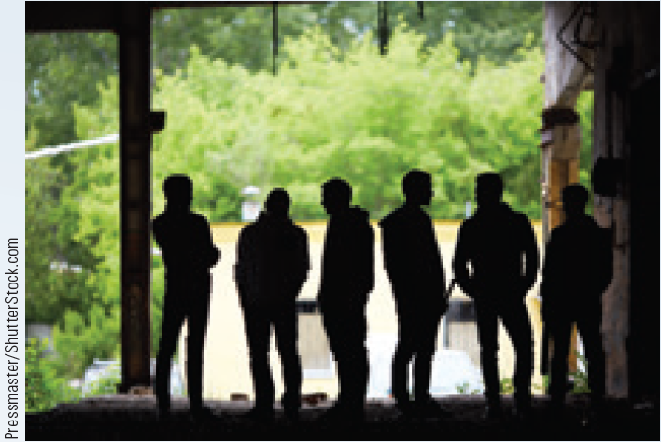
Careers in Criminal Justice (Continued 3)
Training required
Minimum qualification - High school diploma
Education or experience equivalent to three to five years’ social service employment involving youth
Preferably a bachelor’s degree in counselling or criminal justice
Annual salary range
$50,000-$60,000

Slide 26
Key Terms
Determinate sentencing
Good time
Truth-in-sentencing laws
Presentence investigative report
Real offense
Mitigating circumstances
Retribution
Just deserts
Deterrence
Incapacitation
Rehabilitation
Restorative justice
Restitution
Indeterminate
sentencing

Slide 27
Key Terms (Continued)
Mandatory sentencing guidelines
Habitual offender laws
Victim impact statement (VIS)
Capital punishment
Aggravating
circumstances
Sentencing
disparity
Sentencing
discrimination
Sentencing
guidelines
Departure

Slide 28
Summary
Retribution, deterrence, incapacitation, and rehabilitation are the philosophical reasons for sentencing criminals
VIS attempts to increase the harshness of the sentence
In the bifurcated procedure, the jury determines guilt or innocence of the defendant and decides if the death sentence is warranted

Slide 29
End

