Slide 1
Chapter 8

Slide 2
Learning Objectives
Identify the steps involved in the pretrial criminal process
Indicate why prosecutors, defense attorneys, and defendants often agree to plea bargains
Identify the basic protections enjoyed by criminal defendants in the United States
Contrast challenges for cause and preemptory challenges during voir dire
List the standard steps in a criminal jury trial

Slide 3
LO - 1
Identify the steps involved in the pretrial criminal process

Slide 4
Pretrial Criminal Process
Initial appearance: First appearance before a judge or magistrate following an arrest
Pretrial detention
Those charged with misdemeanors are released on a promise to return later for proceedings
Those charged with felony are released only if they post bail
Preventive detention: Retention of an accused person in custody to avoid future crime

Slide 5
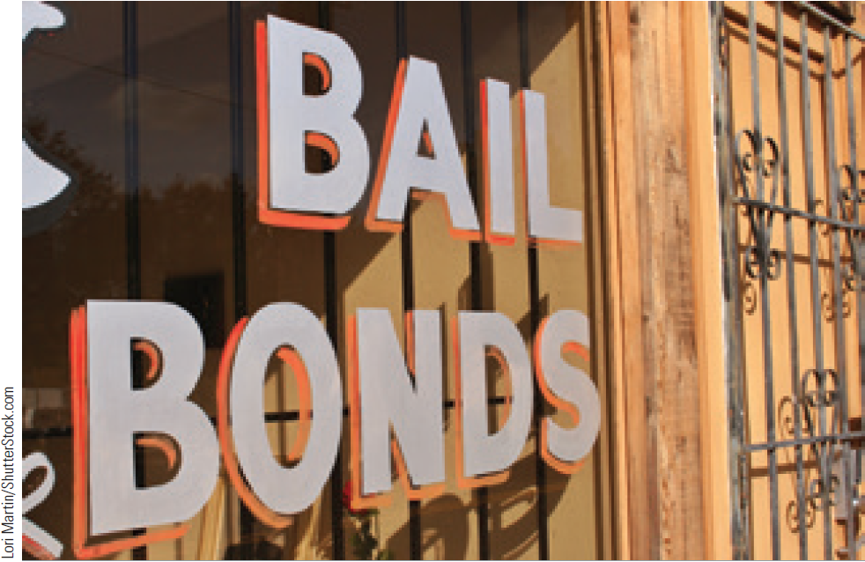
Release
Release on recognizance (ROR)
Release of an accused with the understanding that he or she will return for further proceedings
Property bond
Defendant provides the court with property as an assurance of his or her return
Bail bond agent
Businessperson who agrees to pay the bail amount if the accused fails to appear in court

Slide 6
Procedures for Establishing Probable Cause
Preliminary hearing: A magistrate decides if the defendant committed the crime
Discovery: Formal investigation before trial
Information: Formal charge against the defendant for the purposes of a trial
Grand jury: Group of citizens called to decide whether probable cause exists
Issues indictment if the evidence is sufficient

Slide 7
LO2
LO - 2
Indicate why prosecutors, defense attorneys, and defendants often agree to plea bargains

Slide 8
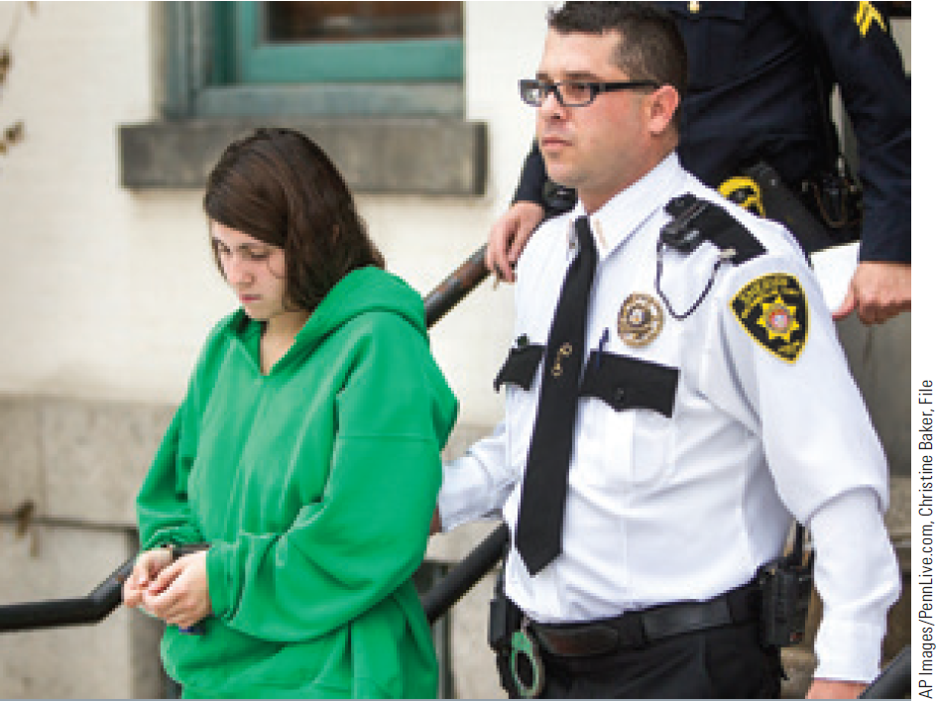
Plea Bargaining
Accused and prosecutor work out a mutually satisfactory conclusion to the case
Occurs after arraignment and before the trial

Slide 9
Plea Bargaining (Continued)
Motivations
Reduce the risk of setting free a guilty defendant
Increase profits by quickly disposing of cases
Allow the defendant a measure of control over his or her fate
Provide victim the right to be heard during the process

Slide 10
LO 3
LO - 3
Identify the basic protections enjoyed by criminal defendants in the United States

Slide 11
Protections Enjoyed by Criminal Defendants
Defendants in the U.S. enjoy the right to:
A speedy and public trial by an impartial judge
Statute of limitations: Limits the amount of time prosecutors have to bring criminal charges against a suspect
Be informed of the nature and causes of accusation
Be confronted with witnesses against him or her
Have compulsory process for obtaining witnesses in his favour
Have the Assistance of Counsel for his defense

Slide 12
Role of the Jury
Jury trial: Trial before a judge and a jury
Bench trial: Trial conducted without a jury
Judge makes the determination of the defendant’s guilt or innocence
Acquittal: Declaration following a trial that the individual accused of the crime is innocent

Slide 13
Presumption of a Defendant’s Innocence
Defendant is considered to be innocent until proved guilty
Prosecutor should substantiate the charge with sufficient evidence of the defendant’s guilt
Standard of proof - Defendant is not required to prove innocence

Slide 14
LO4
LO - 4
Contrast challenges for cause and preemptory challenges during voir dire

Slide 15
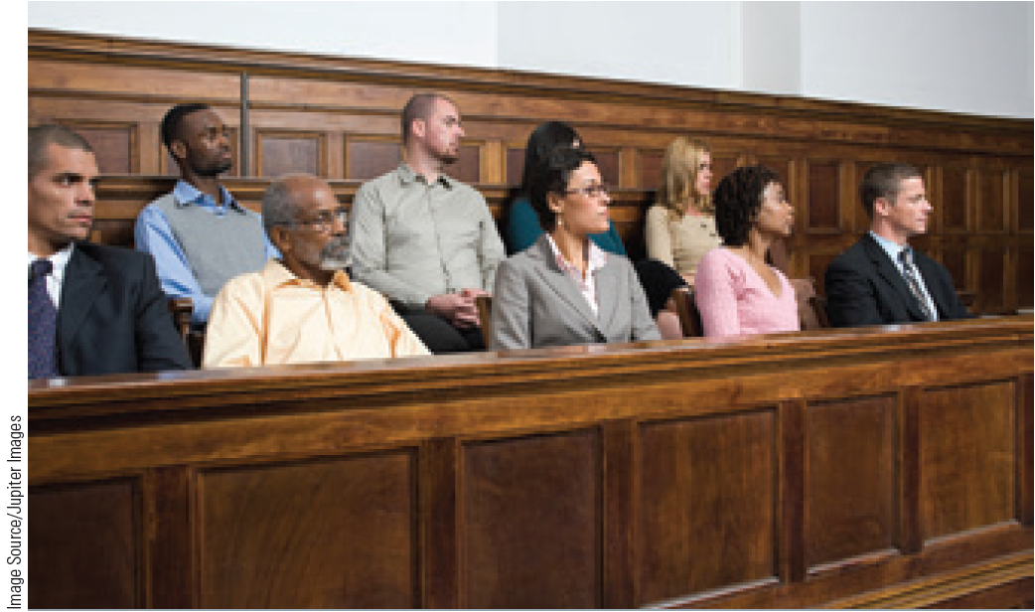
Selection of the Jury
Master jury list: List of citizens from which a jury can be selected
Venire: Group of citizens from which the jury is selected

Slide 16
Voir Dire
Preliminary questions asked to prospective jurors to determine whether they:
Are biased
Have any connection with the defendant or a witness
Challenge for cause
Attorney states the reason why a prospective juror should not be included on the jury
Peremptory challenges
Excluding potential jurors from serving on the jury without any supporting reason or cause

Slide 17
LO 5
LO - 5
List the standard steps in a criminal jury trial

Slide 18
8.3 The Steps of a Jury Trial

Slide 19
Post Criminal Trial
Verdict: Formal decision made by the jury
Hung jury: Members are irreconcilably divided in their opinions and cannot reach a verdict
Allen charge: Judge asks the jurors in the minority to reconsider the majority opinion
Appeals: Process of seeking a higher court’s review of a lower court’s decision
Purpose - To correct or change the decision
Available only to the defense
Primarily concerned with legal innocence

Slide 20
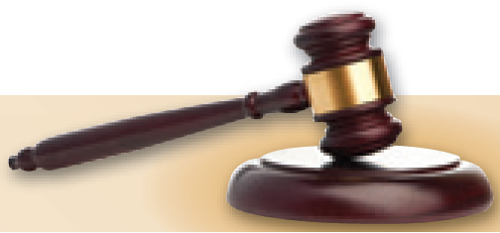
The Steps of an Appeal
Appellant files a notice of appeal
Appellant transfers the trial court record to the appellate court
Both parties file briefs
Attorneys from both sides present oral arguments before the appellate court
Judges of the appellate court deliberate the case and make their decision

Slide 21
Wrongful Convictions
Conviction of a person who is innocent of the charges
Common reasons for wrongful convictions
Eyewitness misidentification
False confessions
Faulty forensic evidence
False informant testimony
Law enforcement misconduct

Slide 22
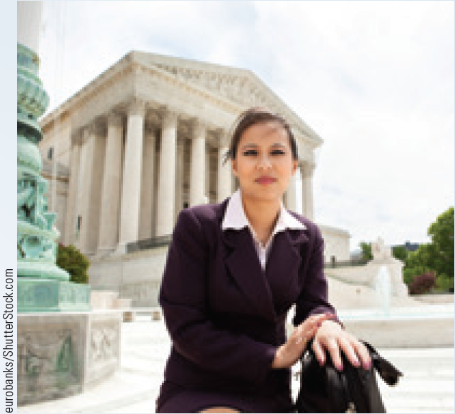
Careers in Criminal Justice: Trial Court Administrator
Job description
Oversee court operations
Establish and maintain working relationships with judges, state attorneys, and public defenders

Slide 23
Careers in Criminal Justice: Trial Court Administrator (Continued)
Training requirement
A bachelor of arts in court administration, and five years of professional experience
A law degree, master’s degree, or certification by the Institute of Court Management
Annual salary range - $30,000-$90,000

Slide 24
Careers in Criminal Justice: Jury Consultant
Job description
Pretrial - Research jurors’ backgrounds, develop voir dire questions, and organize mock trials
During trial - Determine if the client trial lawyer is communicating his arguments successfully

Slide 25
Careers in Criminal Justice: Jury Consultant (Continued)
Training requirement
A bachelor’s degree in sociology, political science, criminology, or psychology
Research and data analysis skills
Annual salary range - $43,000-$110,000

Slide 26
Key Terms
Initial appearance
Bail
Preventive detention
Release on recognizance (ROR)
Property bond
Bail bond agent
Preliminary hearing
Discovery
Grand jury
Information
Indictment
Case attrition
Arraignment
Nolo contendere
Plea bargaining
Statute of limitations
Jury trial
Bench trial
Acquittal
Master jury list
Venire
Voir dire
Challenge for cause
Peremptory challenges
Opening statements

Slide 27
Key Terms (Continued)
Evidence
Testimony
Real evidence
Lay witness
Expert witness
Direct evidence
Circumstantial evidence
Relevant evidence
Direct examination
Confrontation clause
Cross-examination
Hearsay
Rebuttal
Closing arguments
Charge
Sequestration
Verdict
Hung jury
Allen charge
Appeal
Double jeopardy
Wrongful conviction
Habeas corpus

Slide 28
Summary
First step toward determining a suspect’s guilt or innocence is the initial appearance
Protections enjoyed by criminal defendants
Right to a speedy trial
Right to an impartial jury
Steps in a criminal jury trial
Making open statements
Presenting evidence
Directing examination, cross-examination, rebuttal, and surrebuttal
Closing arguments

Slide 29
End

