Slide 1
Chapter 7

Slide 2
Learning Objectives
Define jurisdiction and contrast geographic and subject-matter jurisdiction
Explain the difference between trial and appellate courts
Explain briefly how a case is brought to the Supreme Court
List the different names given to public prosecutors and indicate the general powers they have
Explain why defense attorneys must often defend clients they know to be guilty

Slide 3
LO1
LO - 1
Define jurisdiction and contrast geographic and subject-matter jurisdiction

Slide 4
Functions of Courts
Due process
Crime control
Rehabilitation
Bureaucratic

Slide 5
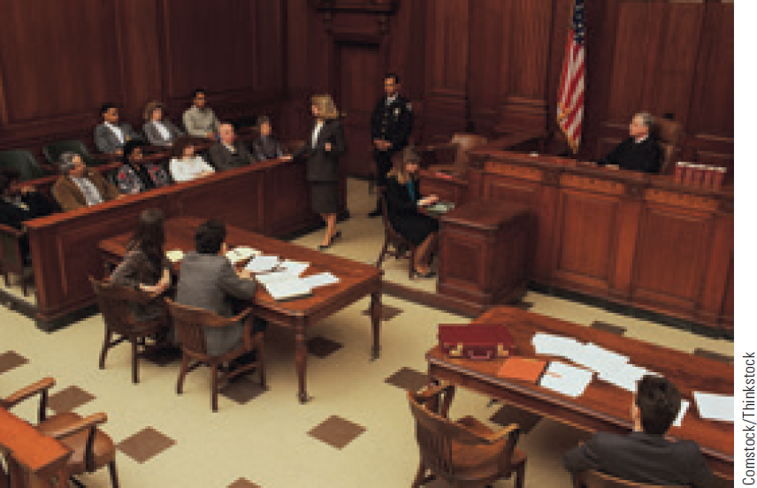
Jurisdiction
Authority of a court within an area of the law or a geographic territory
Geographic jurisdiction
Concurrent jurisdiction: Two or more courts have the authority to preside over the same criminal case
Extradition: Transfer of a suspect or fugitive from one legal authority to another

Slide 6
Jurisdiction (Continued)
International jurisdiction - Each country has the right to create and enact criminal law for its territory
Subject-matter jurisdiction - Special subject-matter courts that dispose of cases involving a specific crime

Slide 7
LO2
LO - 2
Explain the difference between trial and appellate courts

Slide 8
Trial and Appellate Courts
Trial courts: Courts in which most cases begin and facts are examined
Appellate courts: Review decisions made by lower courts
Known as courts of appeals

Slide 9
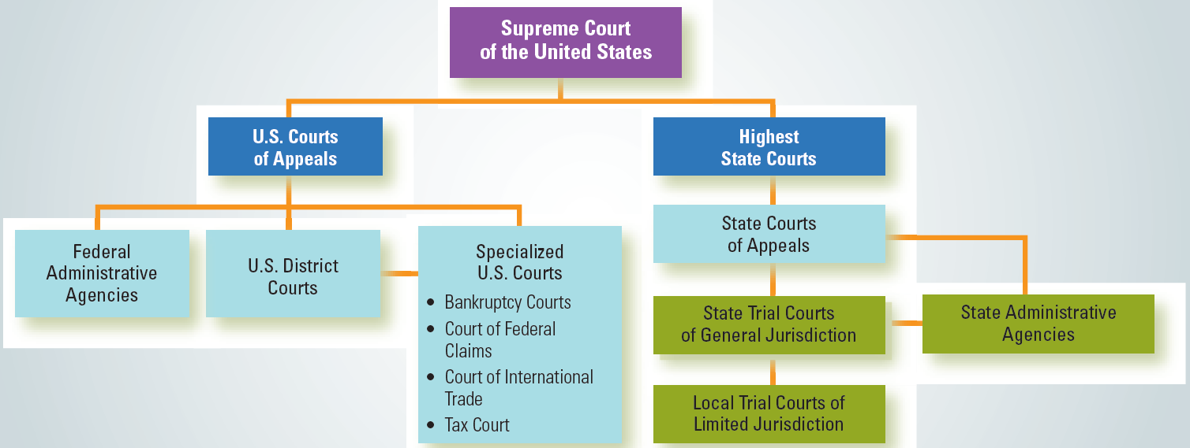
7.1 The Dual Court System

Slide 10
Types of Specialty Courts
Drug courts
Gun courts
Juvenile courts
Domestic violence courts
Mental health courts

Slide 11
Federal Court System
Three-tiered model
U.S. district courts
U.S. courts of appeals
U.S. Supreme Court
Judges are appointed by the president of the United States

Slide 12
LO3
LO - 3
Explain briefly how a case is brought to the Supreme Court

Slide 13
Interpreting and Applying the Law
Supreme Court drafts criminal justice policy through:
Judicial review
Its authority to interpret the law
Writ of certiorari: Request from a higher court to a lower court for the record of a case
Rule of four: Supreme Court will not issue a writ of certiorari unless a minimum of four justices approve of the decision

Slide 14
Concurring Opinions and Dissenting Opinions
Concurring opinions
Prepared by judges who support the decision of the majority of the court but who want to:
Make or clarify a particular point
Voice disapproval of the grounds on which the decision was made
Dissenting opinions
Judges:
Disagree with the conclusion reached by the majority of the court
Expand on their own views about the case

Slide 15
LO4
LO - 4
List the different names given to public prosecutors and indicate the general powers they have

Slide 16
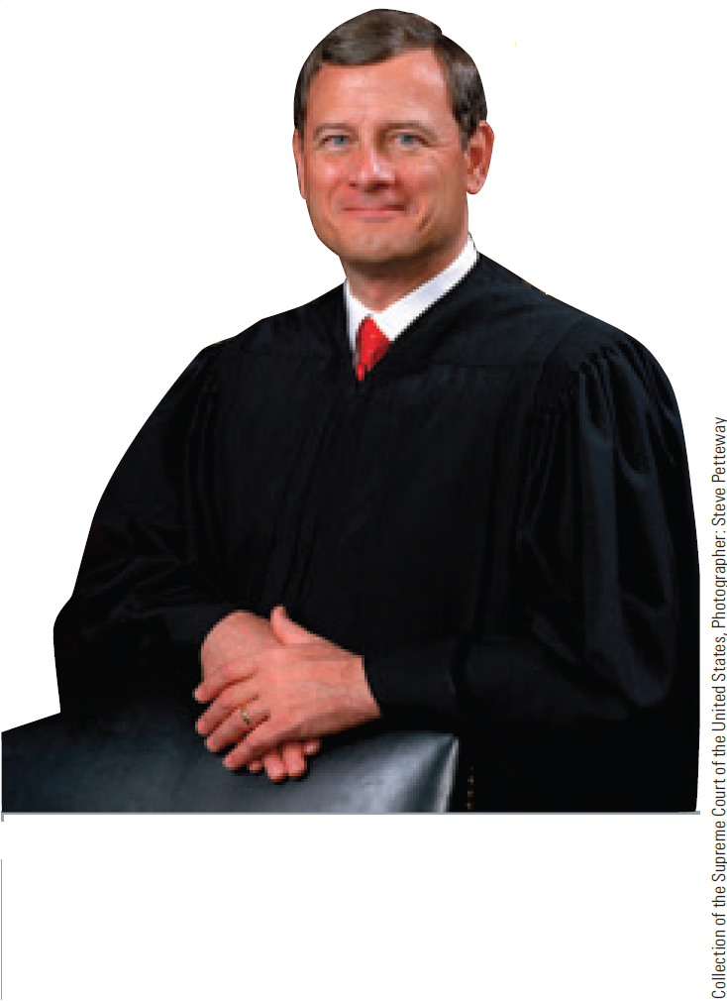
Selection of Judges
Federal judges are appointed by the president and confirmed by the Senate
State judges are appointed by:
Partisan elections
Nonpartisan elections
Missouri plan

Slide 17
Public Prosecutors
Initiate and conduct cases in the government’s name and on behalf of the people
Called prosecuting attorney, state attorney, district attorney, county attorney, or city attorney
Brady rule - Prosecutors are not permitted to keep evidence from the defendant and her or his attorneys

Slide 18
Public Prosecutors (Continued)
Decide:
Whether an individual who has been arrested by the police will be charged with a crime
The level of the charges to be brought against the suspect
If and when to stop the prosecution

Slide 19
LO5
LO - 5
Explain why defense attorneys must often defend clients they know to be guilty

Slide 20
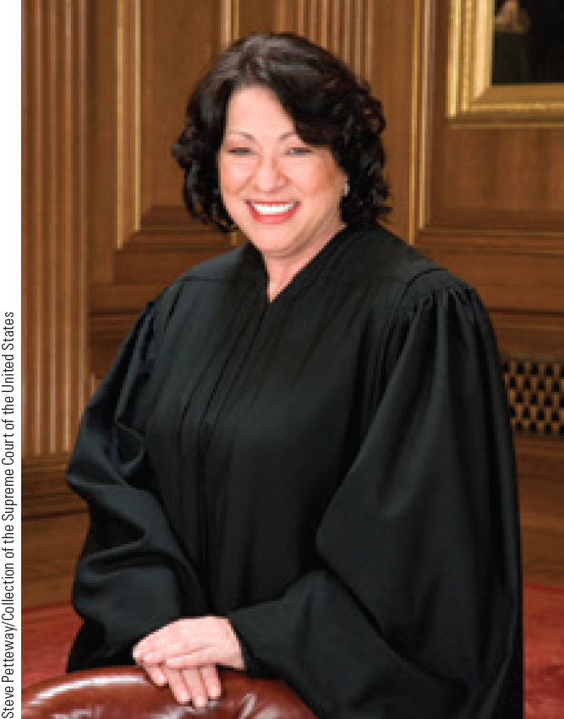
Attorney General
Chief law officer of a state or nation
Has limited control over prosecutors
Appointed or often elected
Serves a minimum four-year term
Has several assistants

Slide 21
Defense Attorney
Lawyer representing a defendant
Private attorney - Hired by individuals
Public defender: Attorneys who represent defendants who cannot afford private counsel

Slide 22
Responsibilities of Defense Attorney
Representing the defendant at the various stages of the custodial process
Investigating the incident
Communicating with prosecutors
Preparing cases for trials
Submitting defense motions
Representing the defendant at trial
Negotiating a sentence
Determining if an appeal is necessary

Slide 23
Programs Used to Allocate Defense Counsel
Assigned counsel programs
Local private attorneys are assigned clients on a case-by-case basis by the county
Contracting attorney programs
Law firm is hired to assume the representative and administrative tasks of indigent defense
Public defender programs
County assembles attorneys and creates a public agency to provide service

Slide 24
Attorney-Client Privilege
A rule of evidence requiring that communications between a client and his/her attorney be kept confidential
Lawyers may disclose the contents if the client consents to disclosure
Exception - Attorney may reveal any information provided by the client about a crime that is yet to be committed

Slide 25
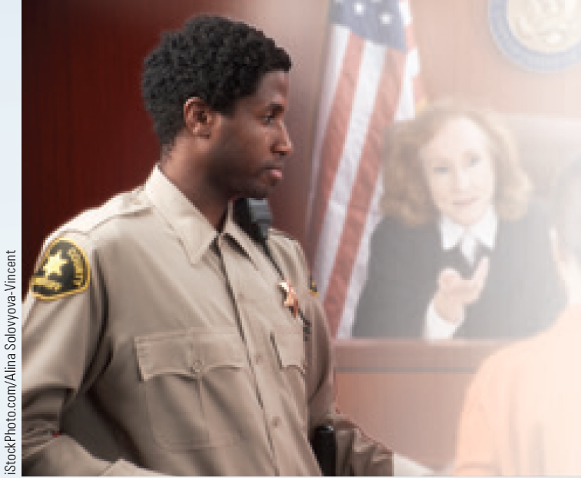
Careers in Criminal Justice: Bailiff
Job description
Maintain order and provide security in the courtroom during trials
Open and close court, call cases, call witnesses, and generally direct the traffic of the trial
Training requirements
A high school diploma or GED
Supplemental training at a police academy
Annual salary range
$25,000-$67,000

Slide 26
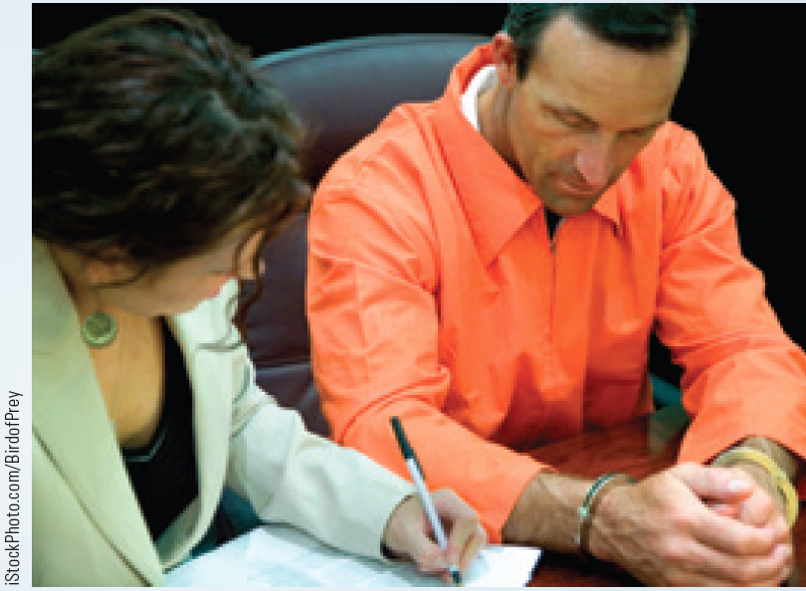
Careers in Criminal Justice: Public Defender
Job description
Interview low-income applicants to check their eligibility for legal services
Help solve the legal problems of the poor
Training requirements
A law degree and membership in the relevant state bar association
Annual salary range
$44,000-$92,000

Slide 27
Key Terms
Jurisdiction
Concurrent jurisdiction
Extradition
Trial courts
Appellate courts
Opinions
Dual court system
Magistrate
Problem-solving courts
Judicial review
Writ of certiorari
Rule of four
Oral arguments
Concurring opinions
Dissenting opinions
Docket
Partisan elections
Nonpartisan elections
Missouri plan
Courtroom work group
Public prosecutors
Attorney general
Defense attorney
Public defenders
Attorney-client privilege

Slide 28
Summary
Jurisdiction is the power to speak the law
Jurisdiction over subject matter acts as a limitation on the types of cases a court can hear
Public prosecutors initiate and conduct cases in the government’s name and on behalf of the people
According to legal ethics, a defense attorney must defend the client whether he/she is innocent or guilty

Slide 29
End

