Slide 1
Chapter 1 – Criminal Justice Today

Slide 2
Learning Outcomes
Define crime, and identify the different types of crime
Outline the three levels of law enforcement
List the essential elements of the corrections system
Define ethics, and describe the role that it plays in discretionary decision making
Contrast the crime control and due process models

Slide 3
LO - 1 Define crime, and identify the different types of crime

Slide 4
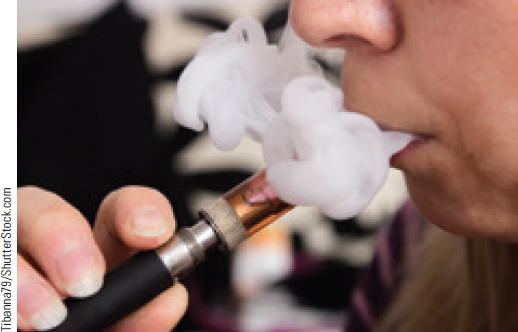
Crime
Act that violates criminal law and is punishable by criminal sanctions
Models of crime
Consensus model
Conflict model

Slide 5
Types of Crime
Violent
Property
Public order
White collar
Organized
High tech

Slide 6
LO - 2 Outline the three levels of law enforcement

Slide 7
Criminal Justice System
Is an interlocking network of:
Law enforcement agencies
Courts
Corrections institutions
Federalism: Form of government in which a written constitution provides for a division of powers between a central government and several regional governments

Slide 8
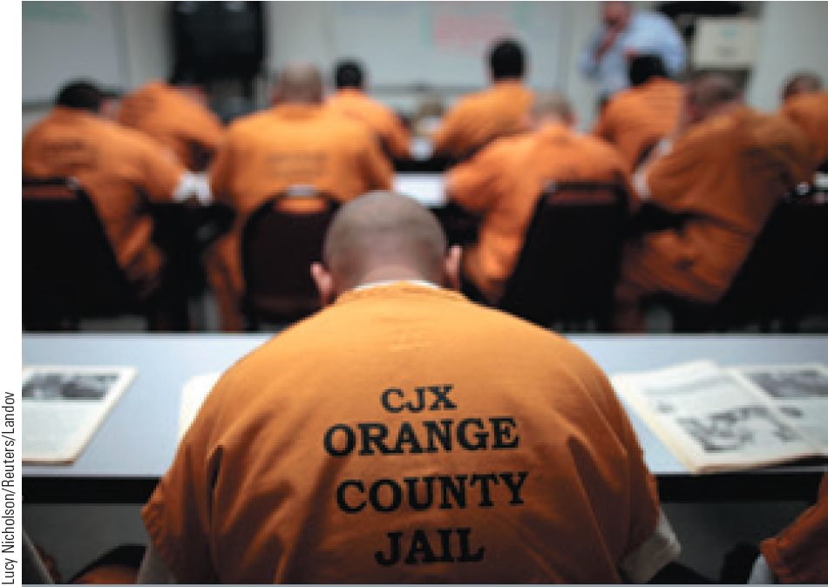
Levels of Law Enforcement
Local - Investigate most crimes and attempt to deter crime through patrol activities
State - Include the state police and highway patrols
Federal agencies - Operate throughout the United States

Slide 9
Courts
The United States has a dual court system
Federal Courts
State Courts
Criminal court and its work group are responsible for determining the innocence or guilt of suspects

Slide 10
LO - 3 List the essential elements of the corrections system

Slide 11
Corrections Systems
Probation
Jails and prisons
Community-based correction

Slide 12
Steps in Criminal Justice Process
Entry into the system
Prosecution and pre-trial services
Adjudication
Sentencing and sanctions
Corrections

Slide 13
LO - 4 Define ethics, and describe the role that it plays in discretionary decision making

Slide 14
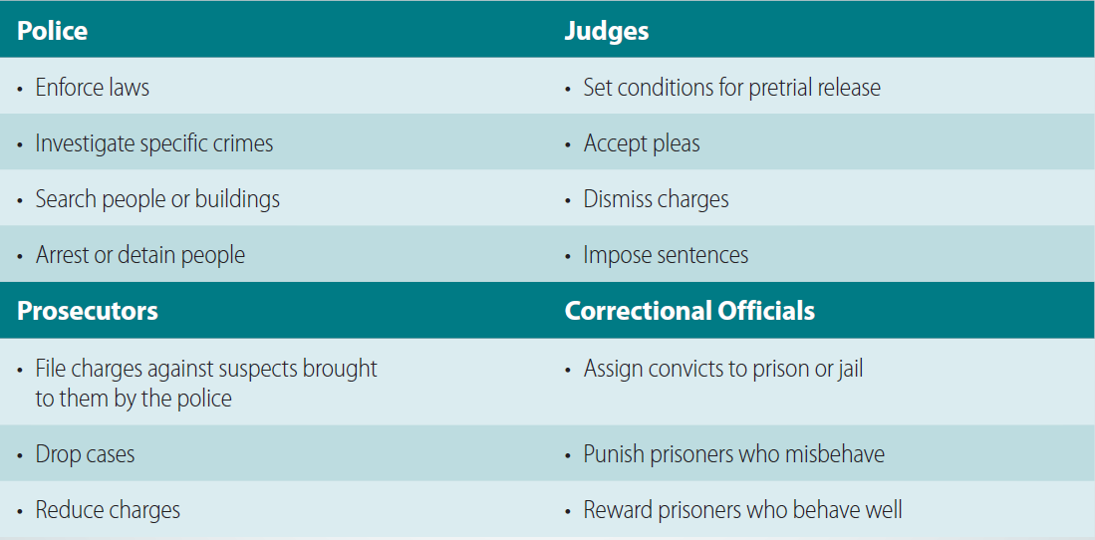
1.3 Discretion in the Criminal Justice System

Slide 15
Ethics and Justice
Ethics: Moral principles that govern a person’s perception of right and wrong
Ethical decision will be intuitive in some cases
Critical thinking is needed for an ethical response

Slide 16
LO - 5 Contrast the crime control and due process models

Slide 17
Crime Control Model and Due Process Model
Crime control model
Places primary emphasis on the right of society to be protected from crime and violent criminals
System must be quick and efficient
Due process model
Places primacy on the right of the individual to be protected from the power of the government
Ultimate goal is fairness, not efficiency

Slide 18
Homeland Security and Domestic Terrorism
Homeland security: Concerted national effort to prevent terrorist attacks within the United States
Reduces the country’s vulnerability to terrorism
Domestic terrorism: Acts of terrorism that take place on U.S. soil without direct foreign involvement

Slide 19
Counterterrorism and Civil Liberties
Efforts to fight terrorism may jeopardize individual civil liberties
Civil liberties: Basic rights and freedoms for American citizens guaranteed by the U.S. Constitution
Critics’ view - Limits should be placed on the government’s ability to collect Big Data
Supporters’ view - Effective counterterrorist tactics are worth minimal privacy intrusions

Slide 20
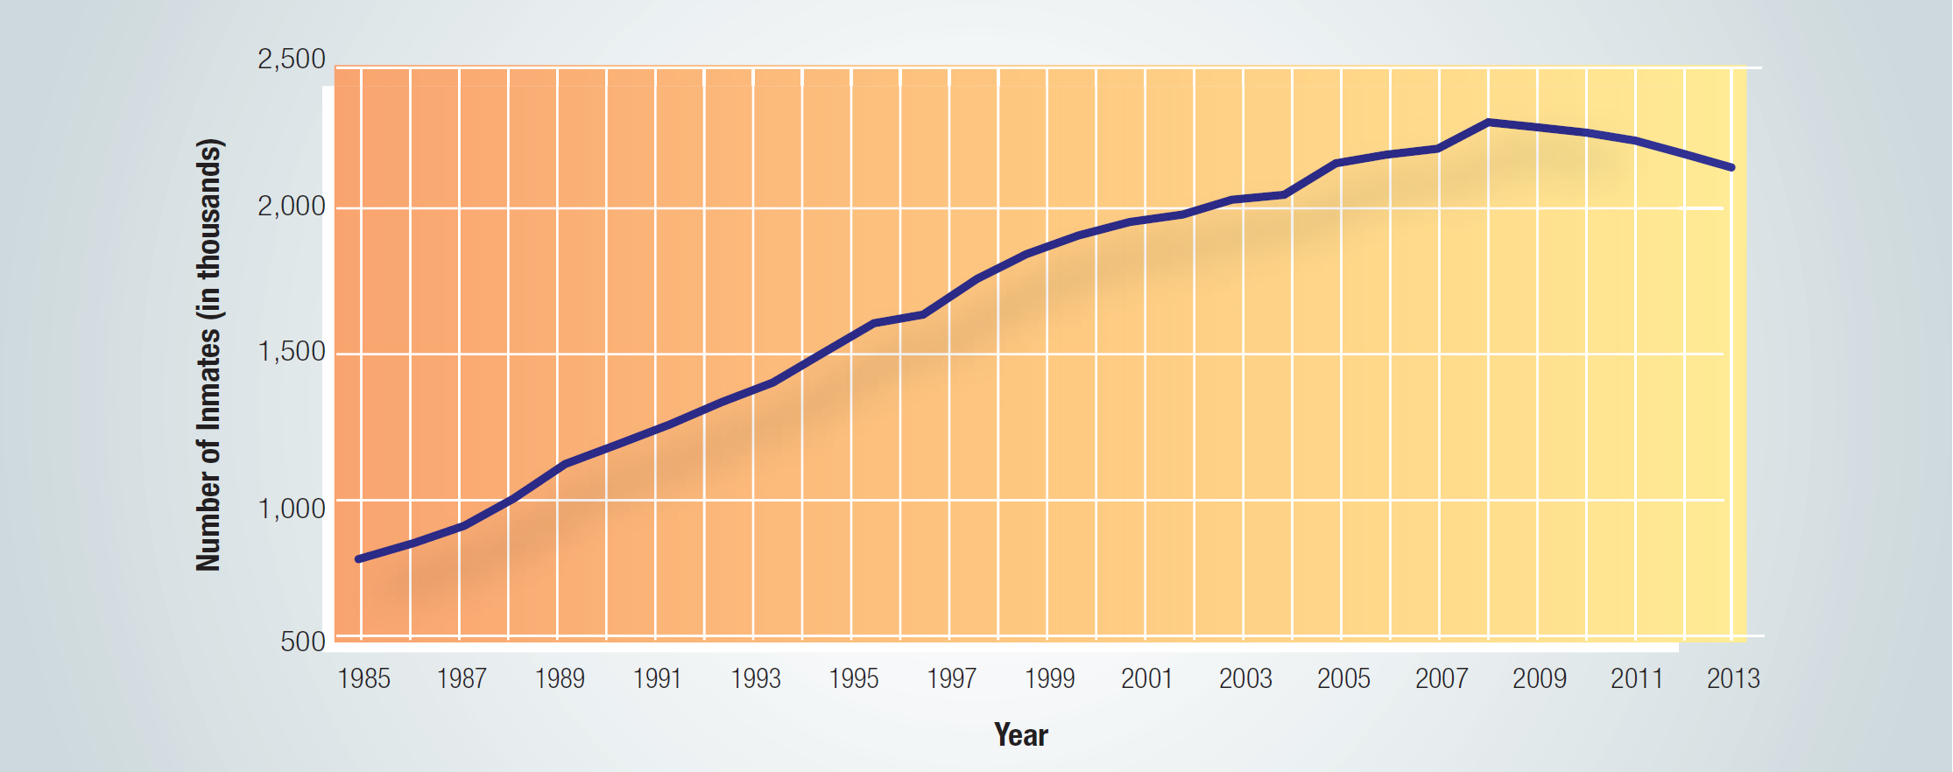
1.4 Prison and Jail Populations in the United States, 1985-2011

Slide 21
Career in Criminal Justice
Crime scene photographer
Job description
Photograph physical evidence and crime scenes related to criminal investigations
Be able to compose reports, testify in court, and operate digital and fluorescent camera equipment

Slide 22
Career in Criminal Justice (Continued 1)
Training requirements
One year in law enforcement or commercial photography or a degree or certificate in photography
Must be willing to work irregular hours, weekends, holidays, and evenings
Annual salary range
$24,000 to $50,000

Slide 23
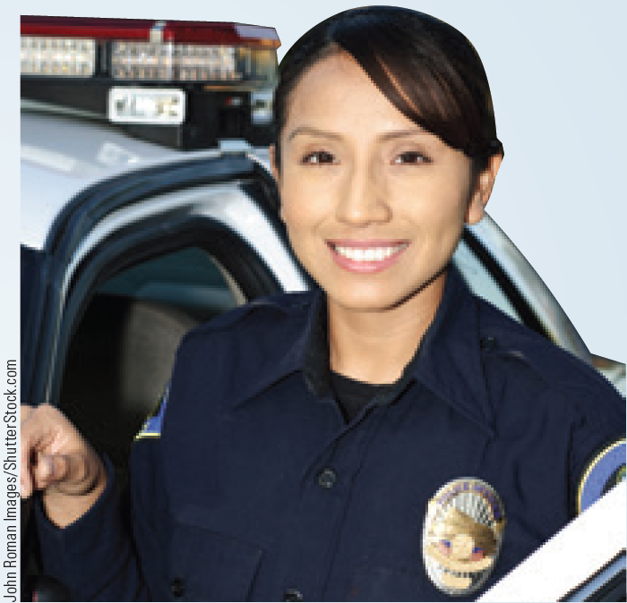
Career in Criminal Justice (Continued 2)
Local police officer
Job description
Protect the lives and property of citizens in the community
Maintain order and prevent crimes
Testify at trials and hearings

Slide 24
Career in Criminal Justice (Continued 3)
Training requirements
Minimum high school graduates
Fulfil minimum height, weight, eyesight, and hearing requirements, and pass physical examinations and background checks
Graduation from a police academy
Annual salary range
$31,000 to $82,000

Slide 25
Key Terms
Crime
Consensus model
Morals
Conflict model
Deviance
Murder
Sexual assault
Assault
Battery
Robbery
Larceny
Burglary
Public order crime
White-collar crime
Organized crime
Criminal justice system
Justice

Slide 26
Key Terms (continued)
Federalism
System
Formal criminal justice process
Discretion
Informal criminal justice process
Ethics
Crime control model
Due process model
Homeland security
Terrorism
Civil liberties
Domestic terrorism
Recidivism
Capital crime

Slide 27
Summary
Crime is an act that violates criminal law and is punishable by criminal sanctions
The two criminal justice models are the consensus model, and the conflict model
The three levels of law enforcement are local, state, and federal
The general direction of the criminal justice system can be described using the crime control model and the due process model

