Slide 1
Chapter 2 – The crime Picture Theories and Trends
Copyright ©2016 Cengage Learning. All Rights Reserved. May not be scanned, copied or duplicated, or posted to a publicly accessible website, in whole or in part.

Slide 2
Learning Objectives
Discuss the difference between a hypothesis and a theory in the context of criminology
Contrast the medical model of addiction with the criminal model of addiction
Distinguish between the National Crime Victimization Survey (NCVS) and self-reported surveys
Describe the three ways that victims’ rights legislation increases the ability of crime victims to participate in the criminal justice system
Identify the three factors most often used by criminologists to explain changes in the nation’s crime rate

Slide 3
LO - 1
Discuss the difference between a hypothesis and a theory in the context of criminology

Slide 4

Criminology
Scientific study of crime and the causes of criminal behavior
  Criminologist - One who studies the causes of crime

Slide 5

2.1 The Scientific Method

Slide 6
Theories of Crime
Rational choice theory
Trait theories of crime
Psychological theories of crime
Sociological theories of crime
Social process theories
Life course theories

Slide 7
Sociological Theories of Crime
Social disorganization
Strain
Social conflict

Slide 8
Stages of Social Disorganization Theory
Poverty
Social disorganization
Breakdown of social controls
Criminal areas
Cultural transmission
Criminal careers

Slide 9
Social Process Theories
Learning theory: Delinquents and criminals must be taught practical and emotional skills needed to participate in illegal activity
Control theory: Assumes that all individuals have the potential for criminal behavior but are restrained by the consequence of such actions on relationships

Slide 10
LO - 2
Contrast the medical model of addiction with the criminal model of addiction

Slide 11
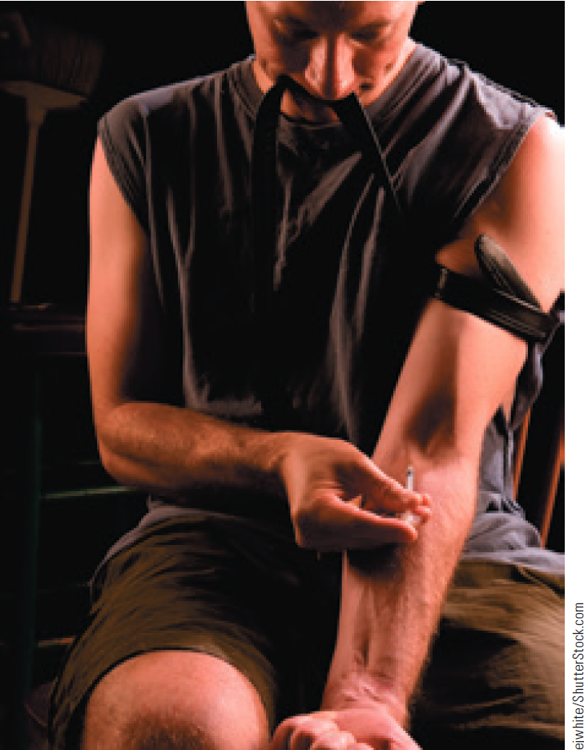
Drug-Crime Relationship
Drug-defined offenses
Drug-related offenses
Drug-using lifestyle

Slide 12
Models of Addiction
Medical model
  Treats drug abuse as a mental illness
  Focuses on treating and rehabilitating offenders rather than providing punishment
Criminal model
  Drug abusers harm society by their actions to the same extent as other criminals and should face the same punitive sanctions

Slide 13
LO - 3
Distinguish between the National Crime Victimization Survey (NCVS) and self-reported surveys

Slide 14
Uniform Crime Report
Annual report compiled by the FBI to give an indication of criminal activity in the United States
  Part I offences
    Murder, rape, robbery, aggravated assault, burglary, larceny, and motor vehicle theft
  Part II offences
    Misdemeanors and felonies
    Drug abuse violations, simple assaults, driving under the influence, and disorderly conduct

Slide 15
Victim Surveys and Self-Reported Surveys
Victim surveys: Directly survey participants to determine their experiences as victims of crime
  Dark figure of crime: Describes the actual amount of crime that takes place
Self-reported surveys: Rely on participants to reveal and detail their own criminal or delinquent behavior

Slide 16
LO - 4
Describe the three ways that victims’ rights legislation increases the ability of crime victims to participate in the criminal justice system

Slide 17
Crime Victims’ Rights Act of 2004 (CVRA)
Gives victims the right to participate in the system
Provides the right to be:
  Informed
  Present
  Heard

Slide 18
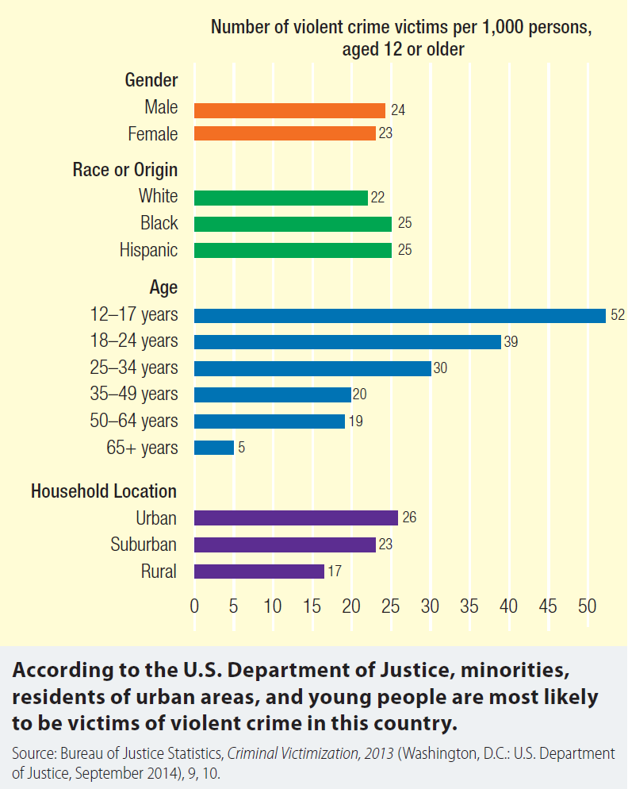
2.6 Crime Victims in the United States

Slide 19
LO - 5
Identify the three factors most often used by criminologists to explain changes in the nation’s crime rate

Slide 20
Factors That Help Study Crime Trends
Imprisonment
  Offender in a prison is unable to commit crime on the street
  Potential perpetrator does not want to be in jail
Youth populations
  Older individuals commit fewer crimes
Economy
  When legitimate opportunities to earn become scarce, illegitimate methods are sought

Slide 21
Reasons for Fall in Crime Rates in the United States
Continuous improvements in law enforcement
Aging population
Improvements in digital technology
Gentrification of formerly high-crime neighborhoods

Slide 22

Careers in Criminal Justice: Criminologist
Job description
  Analyze criminal and delinquent behavior and provide theoretical explanations
  Work with and for law enforcement agencies to prevent crime

Slide 23
Careers in Criminal Justice: Criminologist
Training requirements
  Research skills, computer proficiency, and expertise in statistics
  An undergraduate degree in a field relating to criminal justice with, preferably, a minor in psychology or sociology
Annual salary range
  $40,000-$122,000

Slide 24
Careers in Criminal Justice: National Victim Advocate
Job description
  Provide direct support, advocacy, and short-term crisis counseling to crime victims
  Act as liaison between victims or witnesses and district attorneys or law enforcement that provide court support for victims
Training requirement
  Bachelor’s degree in criminal justice, social work/psychology, or a related field

Slide 25
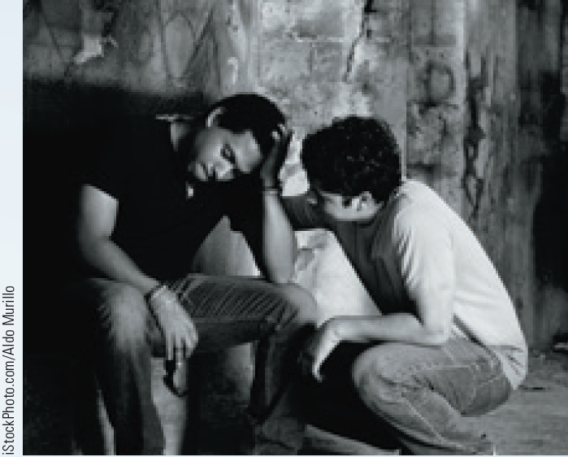
Careers in Criminal Justice: National Victim Advocate (continued)
    Minimum of two years’ experience in the criminal justice system, one year of which should have involved direct services with victims
Annual salary range
  $45,000-$65,000

Slide 26
Key Terms
Criminology
Correlation
Causation
Theory
Hypothesis
Rational choice theory
Biology
Psychology
Hormone
Testosterone
Social psychology
Sociology
Strain theory
Anomie
Social conflict theories
Social process theories
Learning theory
Control theory
Life course criminology
Drug

Slide 27
Key Terms (Continued 1)
Psychoactive drug
Drug abuse
Medical model of addiction
Criminal model of addiction
Decriminalization
Legalization
Uniform Crime Report (UCR)
Part I offences
Part II offenses
Victim surveys
Dark figure of crime
Self-reported survey
Victim
Repeat victimization
Domestic violence
Stalking

Slide 28
Summary
Criminology is the scientific study of crime and the causes of criminal behavior
The different theories of crime focus on the psychological and physical aspects of criminal behavior
CVRA provides victims the right to participate in the system
Changes in crime rate are attributed to imprisonment, youth populations, and the economy

