Slide 1
Chapter 5

Slide 2
Learning Objectives
Explain why police officers are allowed discretionary powers
List the three primary purposes of police patrol
Describe how forensic experts use DNA fingerprinting to solve crimes
Determine when police officers are justified in using deadly force
Explain what an ethical dilemma is and name four categories of ethical dilemmas typically faced by a police officer

Slide 3
LO - 1 Explain why police officers are allowed discretionary powers

Slide 4
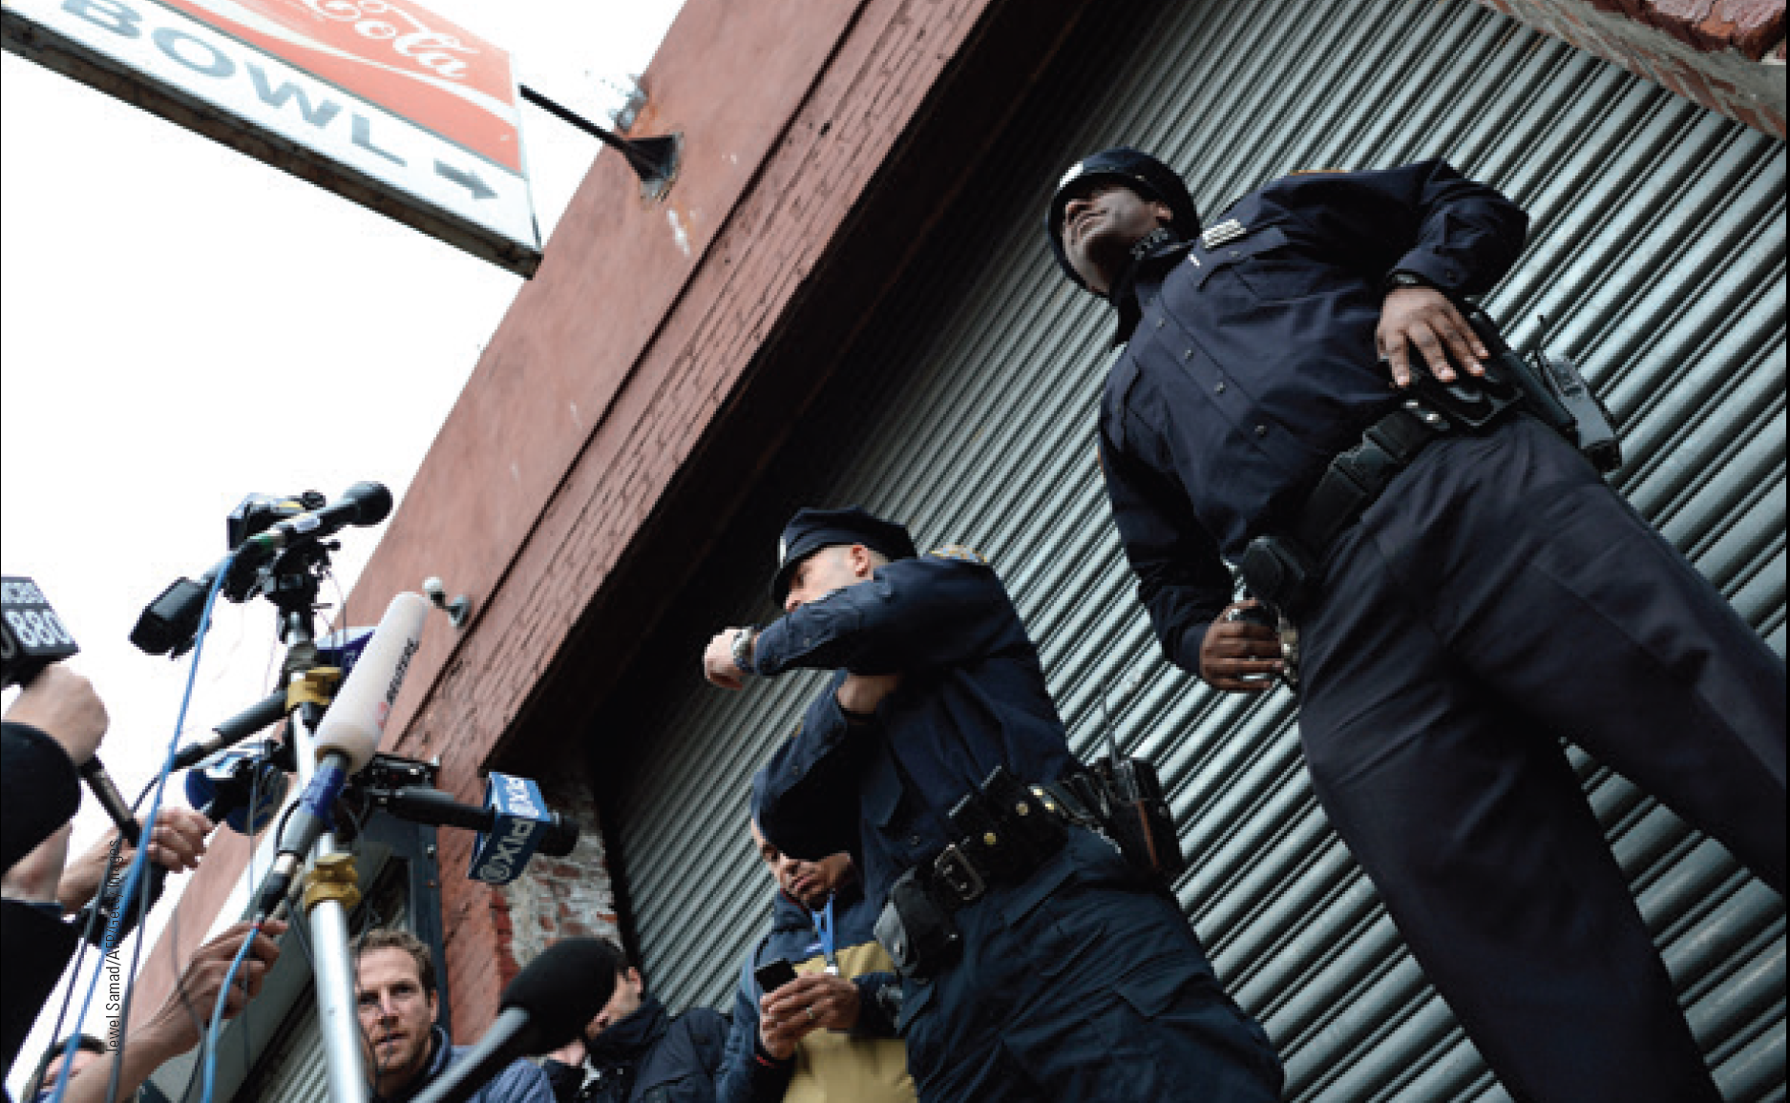
Elements of Discretion
Nature of the criminal act
Attitude of the wrongdoer toward the officer
Relationship between the victim and offender
Departmental policy

Slide 5
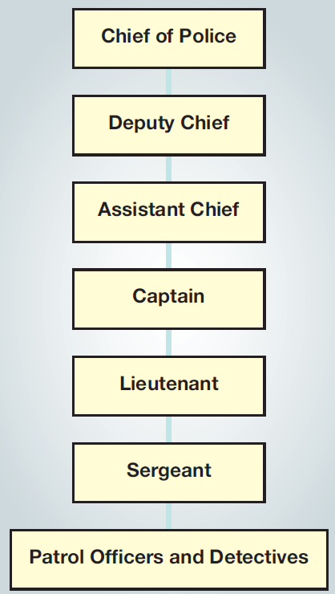
5.1 A Typical Police Department Chain of Command

Slide 6
LO2
LO - 2 List the three primary purposes of police patrol

Slide 7
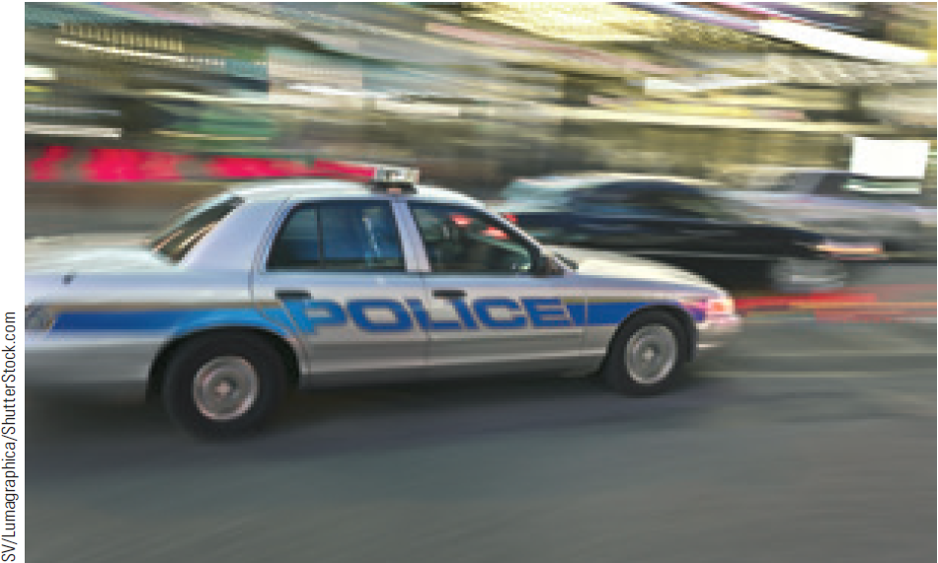
Purpose of Patrol
Deterrence of crime by maintaining visible police presence
Maintenance of public order and sense of security in the community
Provide services that are not crime related

Slide 8
Patrol Activities
Preventive patrol
Calls for service
Administrative duties
Officer-initiated activities

Slide 9
LO3
LO - 3 Describe how forensic experts use DNA fingerprinting to solve crimes

Slide 10
Facts Determined by Forensic Experts
Cause of death or injury
Time of death or injury
Type of weapon or weapons used
Identity of the crime victim
Identity of the offender

Slide 11
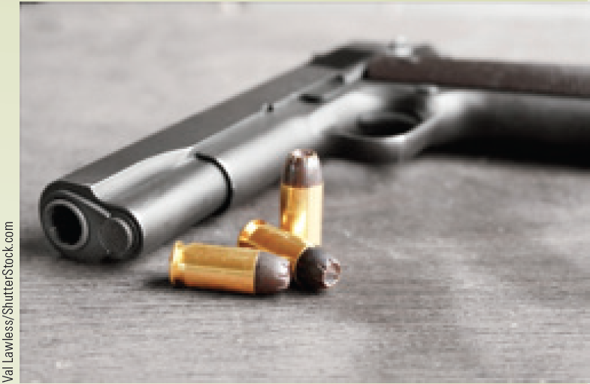
DNA Revolution
Technique of using DNA fingerprinting to match the suspect to a crime

Slide 12
Patrol Strategies
Incident-driven policing
Reactive approach that emphasizes a speedy response to calls for service
Computer-aided dispatch (CAD)
Dispatching police patrol units to the site of emergencies using a computer program
Random patrol
Police officers monitor a certain area with the goal of detecting crimes in progress or preventing crimes

Slide 13
Patrol Strategies
Directed patrol
Focuses on a specific type of criminal activity in a specific geographical location
Hot spots
Concentrated areas of high criminal activity that draw a directed police response
Crime mapping
Technology that allows crime analysts to identify trends and patterns of criminal behavior within a given area

Slide 14
Arrest Strategies
Reactive arrests: Part of the ordinary routine of police patrol and responses to calls for service
Proactive arrests: Concerted efforts by law enforcement agencies to respond to a particular type of criminal or criminal behavior

Slide 15
Community Policing and Problem-Oriented Policing
Community policing
Emphasizes community support for cooperation with the police in preventing crime
Problem-oriented policing
Requires police to identify potential criminal activity and develop strategies to prevent or respond to criminal activities

Slide 16
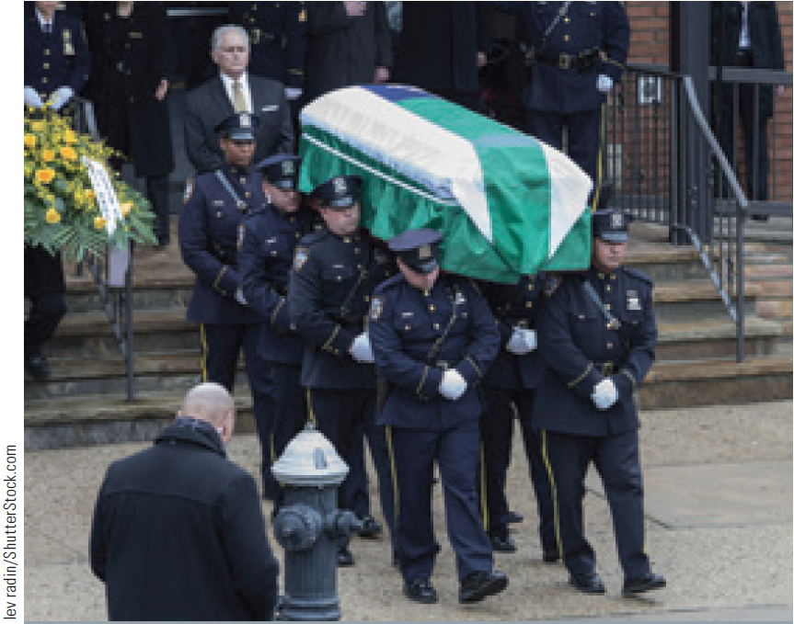
Challenges of Being a Police Officer
Physical dangers
Stress and mental dangers
Authority and use of force

Slide 17
LO4
LO - 4
Determine when police officers are justified in using deadly force

Slide 18
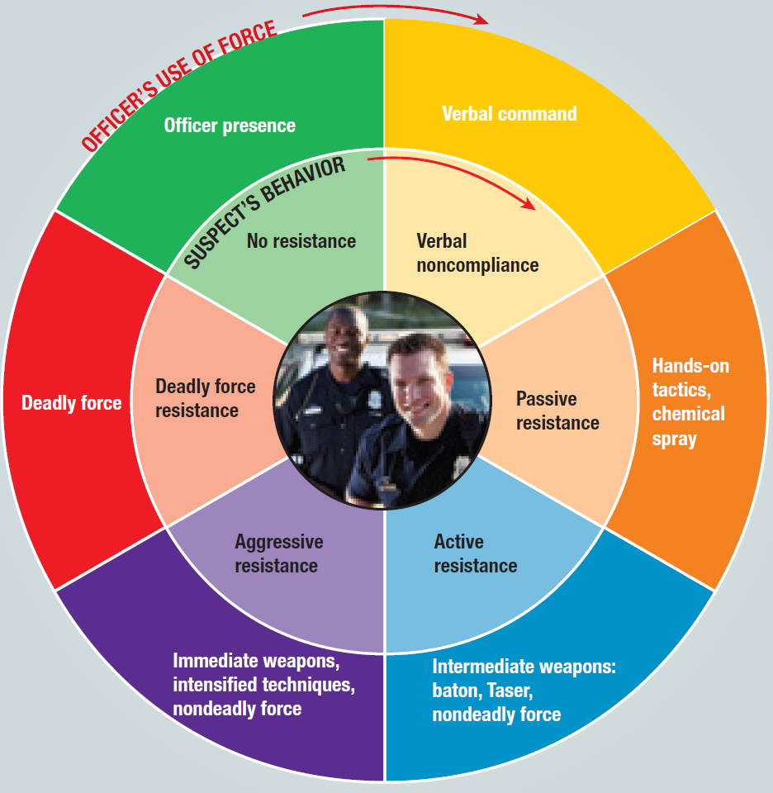
5.3 The Orlando (Florida) Police Department’s Use of Force Matrix

Slide 19
Types of Force
Reasonable force: Degree of force appropriate to protect the police officer or other citizens
Known as nondeadly force
Deadly force: Force applied by a police officer that is likely or intended to cause death

Slide 20
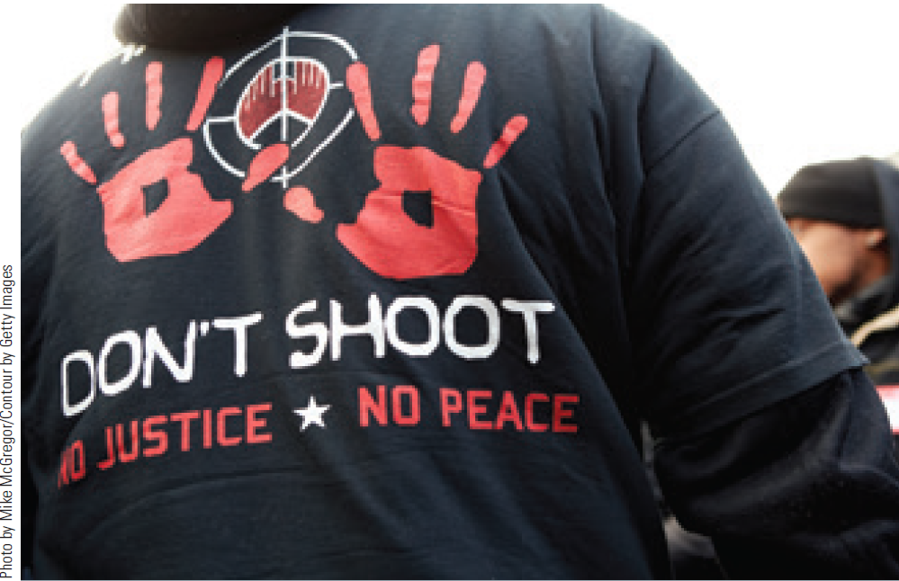
Use of Force and Racial Bias
Racial profiling: Targeting people for police action based on their race, ethnicity, or national origin
Civil rights violation: Interference with a citizen’s constitutional rights by a civil servant

Slide 21
LO5
LO - 5
Explain what an ethical dilemma is and name four categories of ethical dilemmas typically faced by a police officer

Slide 22
Ethical Dilemma
Situation where law enforcement officers:
Have difficulty doing what is right
Are unaware of the right course of action
Find the wrong choice tempting
Noble cause corruption: Intentional misconduct by a police officer to attain what the officer believes is a just result

Slide 23
Elements of Ethics
Discretion
Duty
Honesty
Loyalty

Slide 24
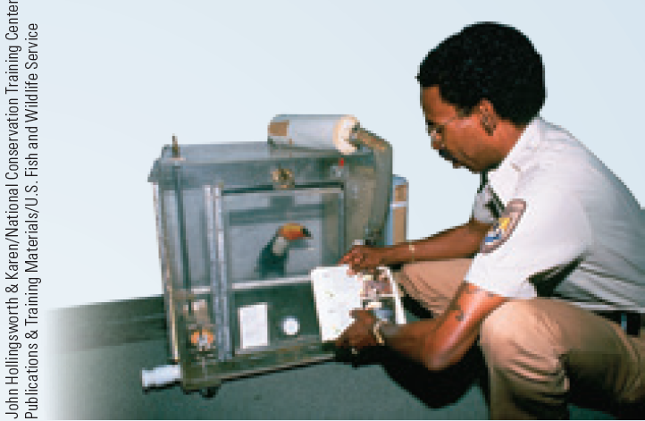
Careers in Criminal Justice: Fish and Wildlife Service Officer
Job description
Protect the integrity of America’s natural habitat
Training requirements
Basic Land Management Police Training
Two-week Refuge Officer Basic School course
Ten-week Field Training and Evaluation Program
Annual salary range - $38,000-$62,000

Slide 25
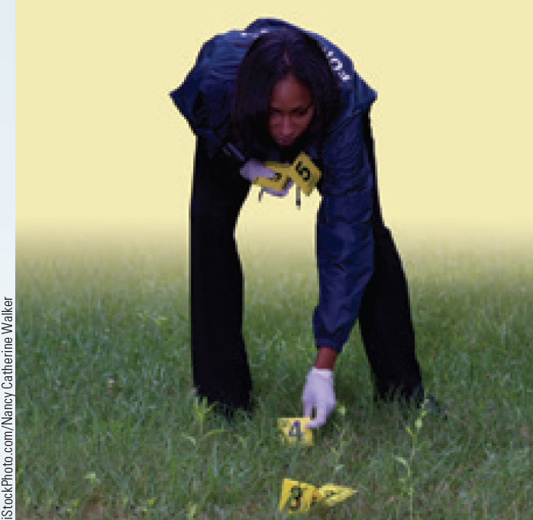
Careers in Criminal Justice: Forensic Scientist
Job description
Examine, test, and analyze evidence collected at a crime scene
Testify as an expert witness in criminal trials
Training requirements
A bachelor’s degree in science
Certification programs for specializations
Annual salary range - $52,000-$85,000

Slide 26
Key Terms
Policy
Bureaucracy
Delegation of Authority
Detective
Confidential Informant (CI)
Clearance rate
Cold case
Forensics
Trace evidence
Ballistics
DNA fingerprinting
Cold hit
Incident-driven policing
Computer-aided dispatch
Random patrol
Directed patrol
Hot spots
Crime mapping

Slide 27
Key Terms (Continued)
Reactive arrests
Proactive arrests
Broken windows theory
Community policing
Problem-oriented policing
Police subculture
Socializing
Blue curtain
Stressors
Burnout
Reasonable force
Deadly force
Racial profiling
Civil rights violation
Police corruption
Noble cause corruption
Duty

Slide 28
Summary
Purpose of police patrol
Deter crime, maintain public order and a sense of security, and twenty-four-hour provision of services that are not crime related
DNA fingerprinting is the identification of a person based on a sample of her or his DNA
Police officers and civilians equate terms such as authority and respect with the ability to use force
Categories of ethical dilemmas
Discretion, duty, honesty, and loyalty

Slide 29
End

