Slide 1
Chapter 6

Slide 2
Learning Objectives
Outline the four major sources that may provide probable cause
Explain when searches can be made without a warrant
Distinguish between a stop and a frisk, and indicate the importance of the case Terry v. Ohio
List the four elements that must be present for an arrest to take place
Indicate situations in which a Miranda warning is unnecessary

Slide 3
LO - 1 Outline the four major sources that may provide probable cause

Slide 4
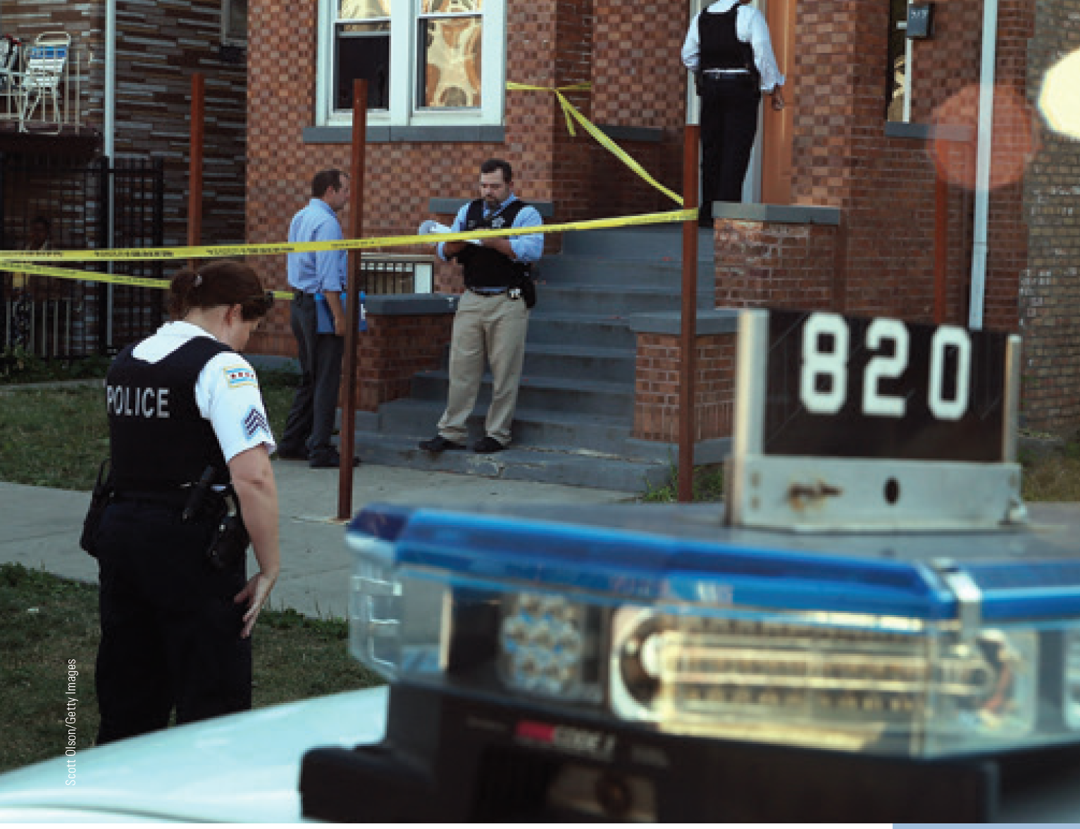
Legal Concepts of the Fourth Amendment
Prohibition against unreasonable searches and seizures
Requirement of probable cause to issue a warrant

Slide 5
Sources of Probable Cause
Personal observation
Information
Evidence
Association

Slide 6
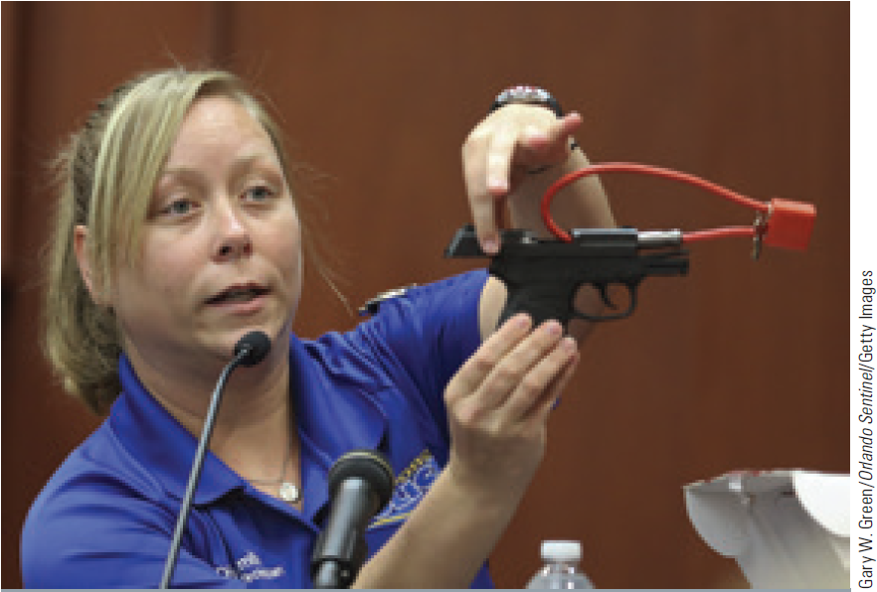
Exclusionary Rule
Evidence obtained in violation of the accused’s rights will not be admissible in criminal court
Exceptions
Inevitable discovery exception
Good faith exception

Slide 7
LO - 2 Explain when searches can be made without a warrant

Slide 8
Search Warrant
Written order commanding police officers to search a specific person, place, or property to obtain evidence
Requires following information
Probable cause that a crime has been or will be committed
Premises to be searched
Suspects to be found
Illegal activities taking place at the premises
Items to be seized

Slide 9
Items That can be Seized Using a Search Warrant
Items resulting from a crime
Illegal items
Items of evidence
Items used in committing a crime

Slide 10
Searches and Seizures without a Warrant
Searches incidental to arrests
Searches for weapons and evidence that are conducted on persons who have just been arrested
Consent searches: Conducted by police after the subject has agreed to the action

Slide 11
Plain View Doctrine
Objects in plain view of a law enforcement agent may be seized without a warrant and introduced as evidence
Criteria for a warrantless seizure
Officer can easily spot or sense the item
Officer is legally in a position to notice the item
Discovery of the item is inadvertent
Officer immediately recognizes the illegal nature of the item

Slide 12
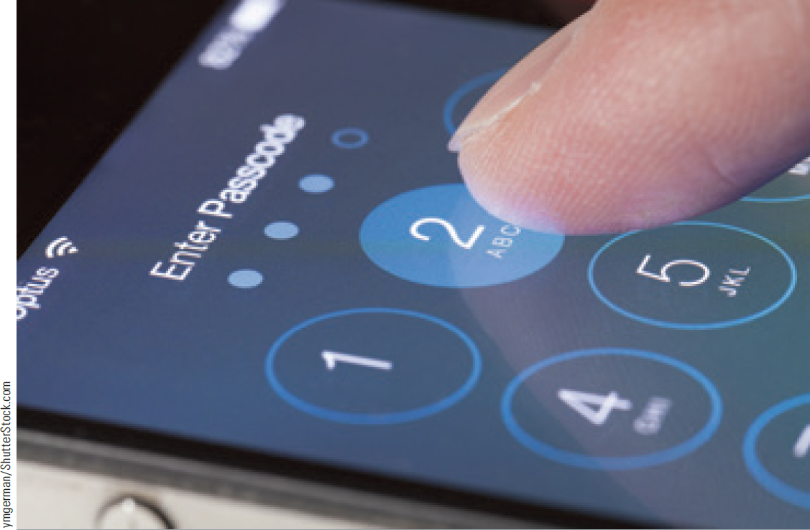
Electronic Surveillance
Use of electronic equipment by law enforcement agents to record private conversations or observe private conduct

Slide 13
LO3
LO - 3 Distinguish between a stop and a frisk, and indicate the importance of the case Terry v. Ohio

Slide 14
Stop and Frisk
Stop: Brief detention of a person by law enforcement agents for questioning
Frisk: Pat-down or minimal search by police to discover weapons

Slide 15
Terry v. Ohio
Detective found three men with suspicious behavior
Suspected men were frisked and handguns were found on two of them
Court concluded that the detectives suspicion was reasonable
Court judgement was based on totality of the circumstances

Slide 16
LO4
LO - 4 List the four elements that must be present for an arrest to take place

Slide 17
Elements of an Arrest
Intent to arrest
Authority to arrest
Seizure or detention
Understanding

Slide 18
6.3 The Difference between a Stop and an Arrest

Slide 19
Arrest
To deprive the liberty of a person suspected of criminal activity
Arrest warrant: Written order commanding that the person named on the warrant be arrested by the police
Based on probable cause and issued by a judge or magistrate
Exigent circumstances: Require extralegal or exceptional actions by the police

Slide 20
Warrantless Arrest
Made without seeking a prior warrant for the action
Is permissible in the following circumstances
Offence is committed in the officer’s presence
Officer believes that the suspect has committed a certain crime
There is a possibility that the suspect could escape or destroy evidence in the time taken to procure a warrant

Slide 21
LO5
LO - 5 Indicate situations in which a Miranda warning is unnecessary

Slide 22
Miranda Warning
A suspect has the right to:
Remain silent
Speak with an attorney and to have the attorney present during questioning
Protects from coercion

Slide 23
When a Miranda Warning is not Required
An officer does not ask the suspect any testimonial questions
Police are questioning witnesses without a focus on the suspect
A person gives information voluntarily
A person has given a statement privately to a friend or acquaintance
During a stop and frisk and a traffic stop

Slide 24
False Confessions
Admission of guilt when the confessor did not commit the crime
Types
Voluntary - Suspect is seeking attention, or is delusional
Internalized -Under the stress of the interrogation, suspect comes to believe that he or she committed the crime
Compliant - Suspect believes that to confess is in his/her best interest

Slide 25
Careers in Criminal Justice: Environmental Protection Agency Criminal Investigation Division Special Agent
Job description
Enforce the nation’s environmental laws
Investigate cases that involve negligent or willful violations of federal environmental laws
Training requirements
Eight weeks training at the Federal Law Enforcement Training Center in Glynco, Georgia
An additional eight weeks of training in conducting investigations
Annual salary range - $43,000-$73,000

Slide 26
Careers in Criminal Justice: Detective
Job description
Collect evidence and obtain facts pertaining to criminal cases
Conduct interviews, observe suspects, examine records, and help with raids and busts

Slide 27
Careers in Criminal Justice: Detective (continued)
Training requirements
Two to five years of experience as police officer
Larger departments require sixty units of college credit or an associate’s degree
Annual salary range - $40,000-$122,000

Slide 28
Key Terms
Searches and seizures
Probable cause
Exclusionary rule
Fruit of the poisoned tree
Inevitable discovery exception
Good faith exception
Search
Search warrant
Affidavit
Seizure
Searches incidental to arrests
Consent searches
Plain view doctrine
Electronic surveillance
Stop
Frisk
Arrest
Arrest warrant
Exigent circumstances
Warrantless arrest
Interrogation
Coercion
Miranda rights
Custody
Custodial interrogation
False confession

Slide 29
Summary
Probable cause is required to issue warrant
Warrants are not needed for consent searches or searches incidental to arrests
Stop is a brief detention of a person but frisking involves minimal search by police
Probable cause is required to make an arrest
Miranda warning provides protection against coercion during custodial interrogation

Slide 30
End

