Slide 1
Chapter 3 Inside Criminal Law

Slide 2
Learning Outcomes
List the four written sources of American criminal law
Discuss the primary goals of civil law and criminal law and explain how these goals are realized
List and briefly define the most important excuse defenses for crimes
Describe the four most important justification criminal defenses
Explain the importance of the due process clause in the criminal justice system

Slide 3
LO - 1 List the four written sources of American criminal law

Slide 4
Written Sources of Criminal Law
Constitutional law: Based on the U.S. Constitution and the various state constitutions
Statutory law: Enacted by legislative bodies
Administrative law: Created by administrative agencies
Case law: Rules of law announced in court decisions

Slide 5
LO 2
LO - 2 Discuss the primary goals of civil law and criminal law and explain how these goals are realized

Slide 6
3.2 Civil Law Versus Criminal Law

Slide 7
Burden of Proof
Is greater in criminal trials than civil ones
Beyond a reasonable doubt
Degree of proof required to find the defendant in a criminal trial guilty of committing the crime
Preponderance of the evidence
Degree of proof required to decide in favor of one side or the other in a civil case

Slide 8
Types of Crime
Felony
Misdemeanor
Infraction
Mala in se
Mala prohibita

Slide 9
Corpus Delicti
Body of circumstances that must exist for a criminal act to have occurred, it includes:
The actus reus, or guilty act
The mens rea, or guilty intent
Concurrence, or the coming together of the criminal act and the guilty mind
A link between the act and the legal definition of the crime
Any attendant, or accompanying, circumstances
The harm done by the crime

Slide 10
Degrees of Crime
First degree murder
Punishable by life in prison or the death penalty
Second degree murder
Punishable by fifteen to twenty-five years in prison
Voluntary manslaughter
Homicide in which the intent to kill was present
Involuntary manslaughter
Homicide in which there was no intent to kill

Slide 11
Criminal Liability
Strict liability crimes: Defendant is guilty regardless of the state of mind at the time of the act
Statutory rape: An adult engages in a sexual act with a minor
Accomplice liability - Being charged of a crime that a person did not actually commit but has acted as an accomplice
Felony-murder: Unlawful homicide that occurs during the attempted commission of a felony

Slide 12
LO - 3 List and briefly define the most important excuse defenses for crimes

Slide 13
Criminal Responsibility and the Law: Infancy and Insanity
Infancy: Status of a person who is below the legal age of majority
Insanity: Defense for lack of criminal responsibility due to mental instability
Competency hearing: Determines the mental ability of the defendant
Tests to determine insanity
M’Naghten rule
ALI/MPC test
Irresistible-impulse test

Slide 14
Criminal Responsibility and the Law: Intoxication and Mistake
Intoxication
Defendant claims that the taking of intoxicants rendered him or her unable to form the requisite intent to commit a criminal act
Mistake
Mistake of law
Mistake of fact

Slide 15
LO - 4 Describe the four most important justification defenses

Slide 16
Justification Defenses
Duress
Unlawful pressure that causes a person to perform a criminal act
Self-defense
Legally recognized privilege to protect one’s self from injury
Necessity
Claim that circumstances forced an individual to commit an illegal act
Entrapment
Claim that a public official forced to commit a crime that the individual would otherwise not have committed

Slide 17
LO - 5 Explain the importance of the due process clause in the criminal justice system

Slide 18
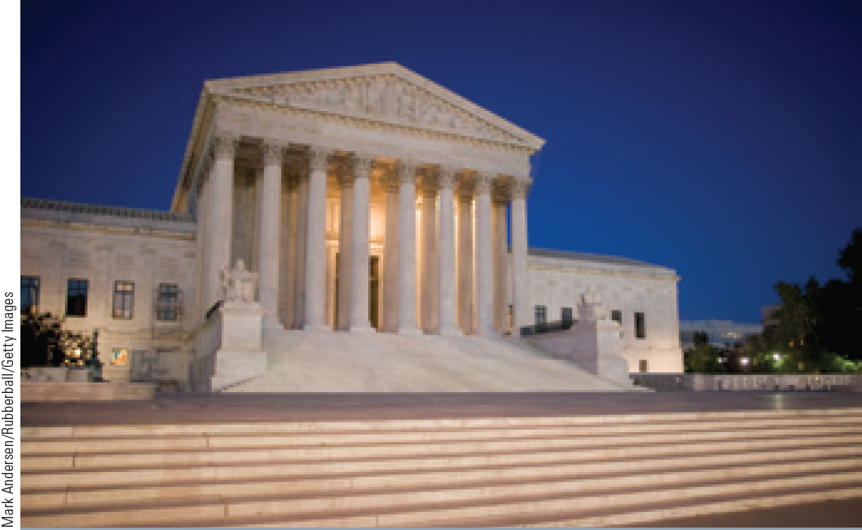
Types of Criminal Law
Substantive criminal law: Defines the rights and duties of individuals with respect to one another
Procedural criminal law: Defines how rights and duties of individuals may be enforced

Slide 19
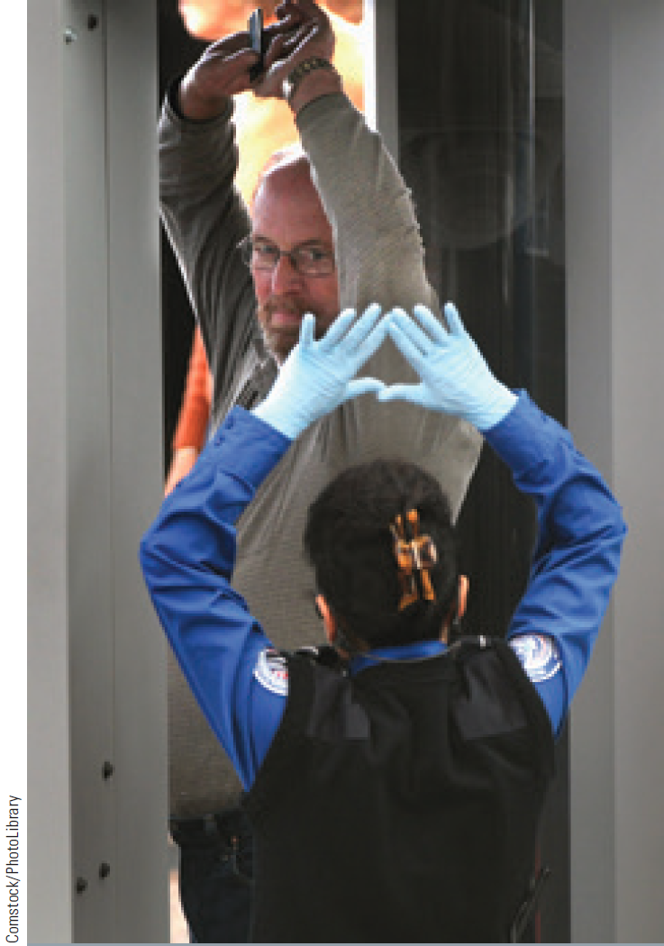
Due Process Clause
Guarantees that no person shall be deprived of life, liberty, or property without due process of law
Types
Procedural due process
Substantive due process

Slide 20
Careers in Criminal Justice: Paralegal/Legal Assistant
Job description
Assist lawyers in all aspects of legal work
Training requirement
Community college-level paralegal program that leads to an associate degree
A certificate in paralegal studies
Annual salary range
$40,000-$77,000

Slide 21
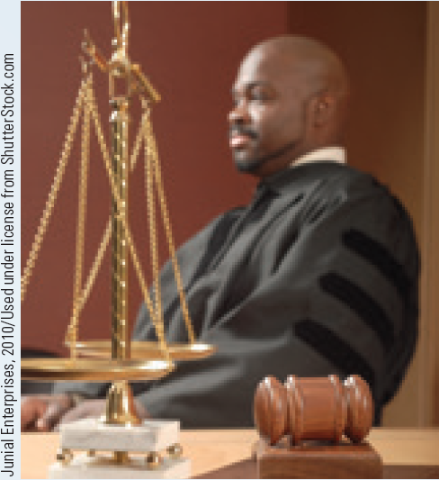
Careers in Criminal Justice: Criminal Court Judge
Job description
Preside over trials and hearings
Rule on admissibility of evidence, monitor the testimony of witnesses, and settle disputes
Training requirement
A law degree and several years of legal experience
Annual salary range
$104,000-$180,000

Slide 22
Key Terms (Continued 1)
Rule of law
Constitutional law
Statutory law
Supremacy clause
Ballot initiative
Administrative law
Precedent
Case law
Stare decisis
Civil law
Plaintiff
Defendant
Liability
Beyond a reasonable doubt
Preponderance of the evidence
Felony
Misdemeanor
Infraction
Mala in se
Mala prohibita
Corpus delicti
Actus reus
Attempt
Mens rea
Negligence
Recklessness
Voluntary manslaughter

Slide 23
Key Terms (Continued 1)
Involuntary manslaughter
Strict liability crimes
Statutory rape
Felony-murder
Attendant circumstances
Hate crime law
Inchoate offenses
Conspiracy
Infancy
Insanity
M’Naghten Rule
Substantial-Capacity Test (ALI/MPC Test)
Irresistible-impulse test
Competency hearing
Intoxication
Duress
Self-defense
Duty to retreat
Necessity
Entrapment
Substantive criminal law
Procedural criminal law
Bill of rights
Due process clause
Procedural due process
Substantive due process

Slide 24
Summary
The American legal system relies on the U.S. Constitution, the state constitutions, the Statutes, regulations created by administrative agencies and case law
Civil law deals with the definition and enforcement of all private and public rights, as opposed to criminal matters
Due process clause guarantees that no person shall be deprived of life, liberty, or property without due process of law

