Slide 1
Chapter 4

Slide 2
Learning Objectives
List the four basic responsibilities of the police
Identify the differences between police academy and field training as learning tools for recruits
Describe the challenges facing women who choose law enforcement as a career
Indicate some of the most important law enforcement agencies under the control of the Department of Homeland Security
Analyze the importance of private security today

Slide 3
LO1
LO - 1 List the four basic responsibilities of the police

Slide 4
Responsibilities of the Police
Enforce laws
Provide services
Prevent crime
Preserve peace

Slide 5
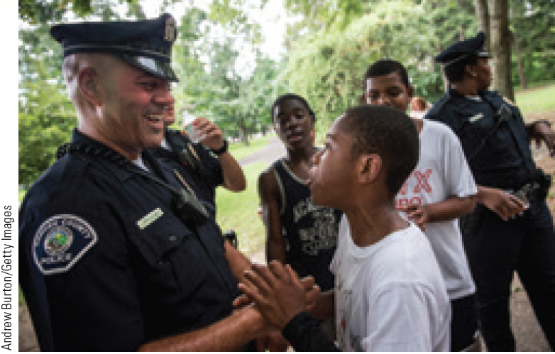
Intelligence-Led Policing
Measures the risk of criminal behavior associated with certain individuals or locations
Known as predictive policing
Requires deploying small forces in areas where the most crime occurs

Slide 6
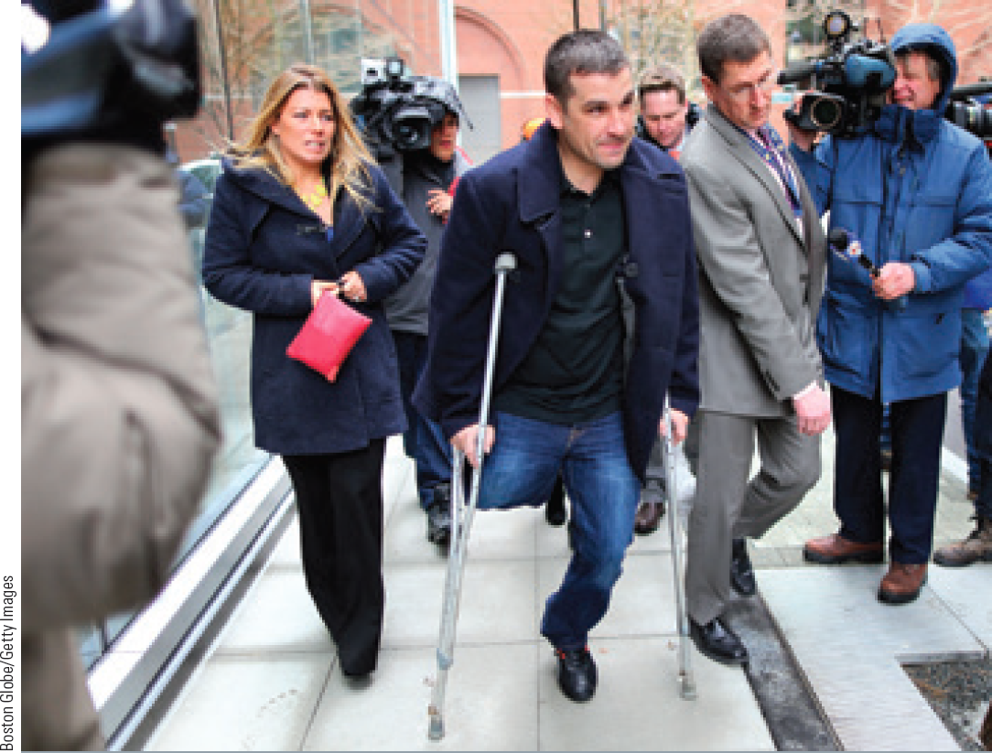
Challenges of Counterterrorism
Scarce resources to fight terrorism
Extensive scrutiny that comes with crimes that have international implications
Difficult task of gathering intelligence about crimes before they occur

Slide 7
LO2
LO - 2 Identify the differences between police academy and field training as learning tools for recruits

Slide 8
Requirements for Becoming an Officer
Be a U.S. citizen
Not have been convicted of a felony
Have or be eligible to have a driver’s license
Be at least twenty one years of age
Meet weight and eyesight requirements

Slide 9
Background Checks and Tests for Police Officers
Drug tests
Review of the applicant’s educational, military, and driving records
Credit checks
Interviews with spouses, acquaintances, and previous employers
Background search to determine any previous convictions for criminal activity

Slide 10
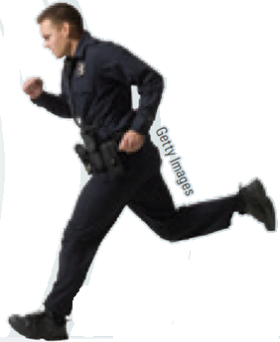
Training
Probationary period: Time at the beginning of a police officer’s career
Recruits learn the basics of police work and are under constant supervision by superiors
Field training: Officer is placed on the beat under the supervision of a senior officer

Slide 11
LO3
LO - 3 Describe the challenges facing women who choose law enforcement as a career

Slide 12
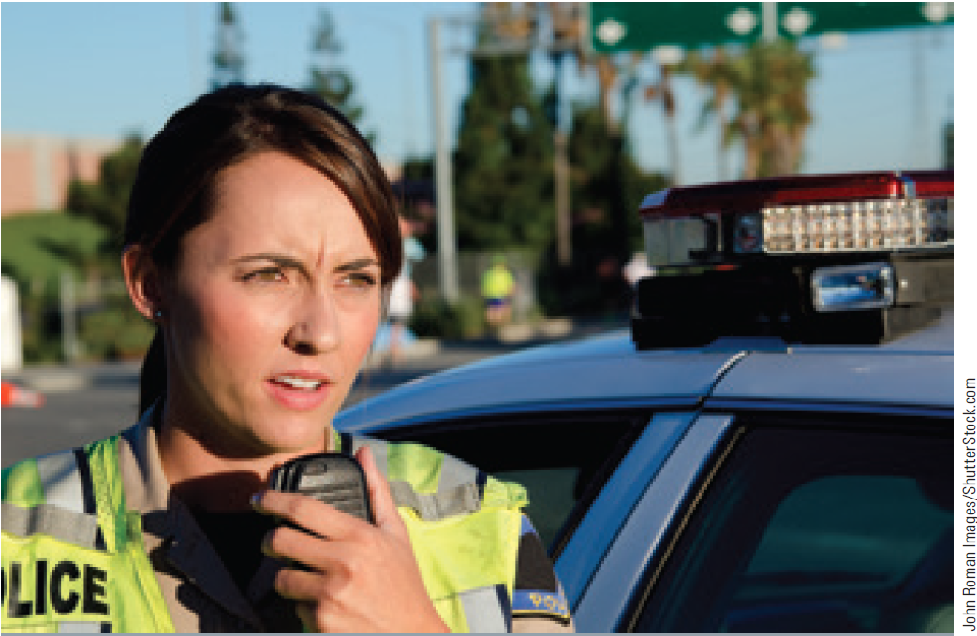
Challenges Faced by Women in the Police Force
Prejudice against female officers
Tokenism - Belief that one has been hired only to satisfy diversity requirements
Sexual harassment: Unwelcome sexual advances and/or obscene remarks in the workplace
Notes:
Prejudice of male officers does not

Slide 13
Challenges Faced by Minorities in the Police Force
Double marginality: Double suspicion that minority officers face from their white colleagues and their community
White officers believe that minority officers give better treatment to members of their own race
Minority officers face hostility from their own community

Slide 14
LO4
LO - 4 Indicate some of the most important law enforcement agencies under the control of the Department of Homeland Security

Slide 15
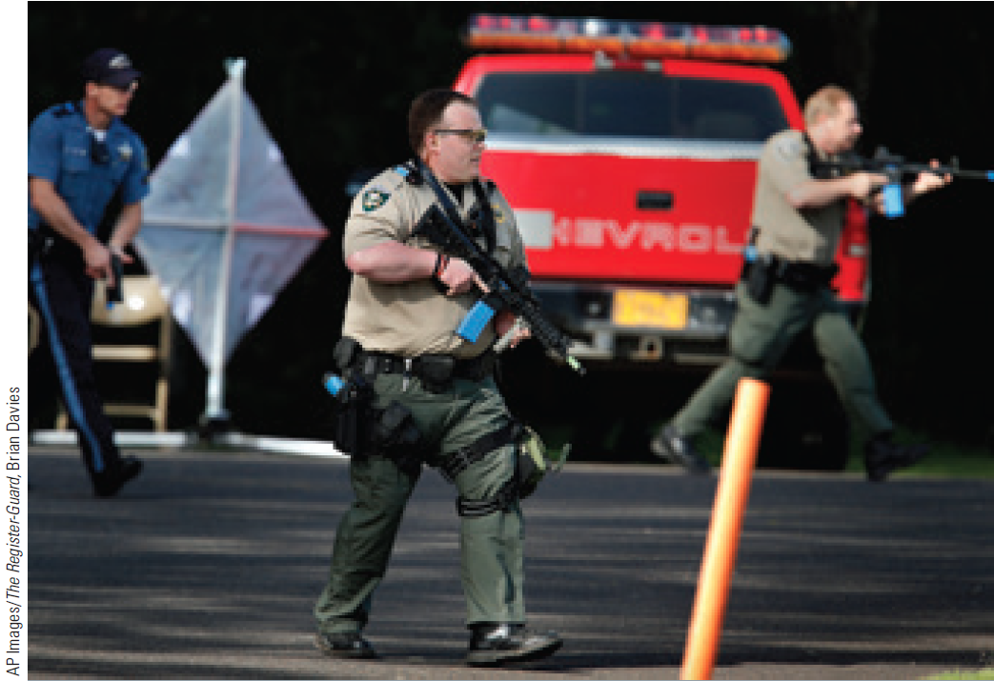
Law Enforcement Agencies
Municipal law enforcement agencies
Sheriffs and county law enforcement
State police and highway patrols

Slide 16
4.3 Federal Law Enforcement Agencies

Slide 17
4.3 Federal Law Enforcement Agencies (continued)

Slide 18
LO5
LO - 5 Analyze the importance of private security today

Slide 19
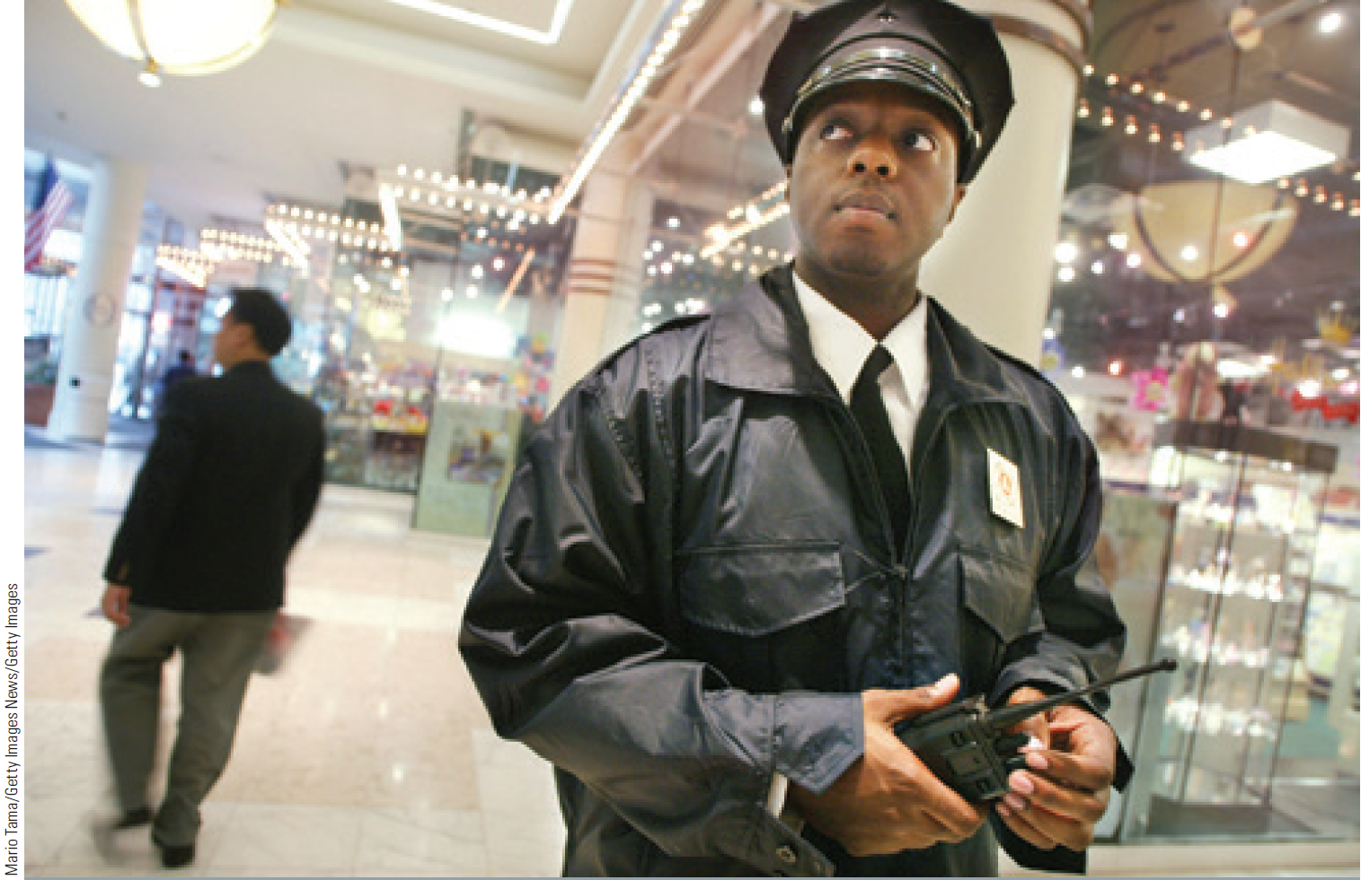
Private Security
Services provided by private corporations or individuals rather than police officers
Guards and patrol services
Intended to deter crime rather than stop it
Each state has its own rules for private security employment

Slide 20
Factors Driving the Growth of Private Security
Increased public fear due to media coverage of crime
Workplace crime
Budget cuts in states and municipalities that have forced reductions in the number of public police
Raised the demand for private ones
Increased awareness of private security products

Slide 21
Careers in Criminal Justice: Federal Bureau of Investigation (FBI) Agent
Job description
Oversee intelligence and investigate federal crimes
Training requirement
A bachelor’s and/or master’s degree, plus three years of work experience
Physical and psychological fitness

Slide 22
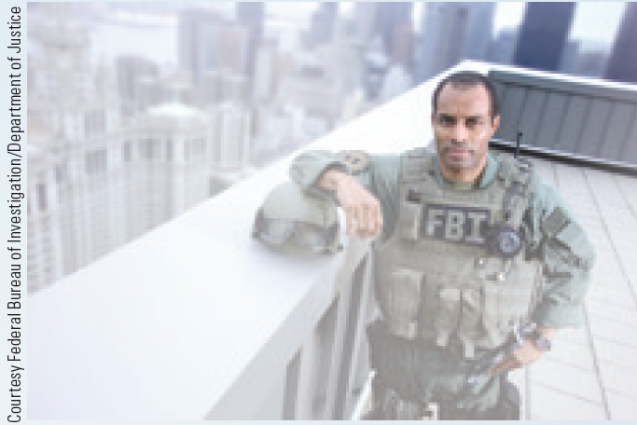
Careers in Criminal Justice: Federal Bureau of Investigation (FBI) Agent (continued)
Critical skills required in one or more of the following areas: accounting, finance, technology, engineering, foreign language(s), law, law enforcement, intelligence, military, and/or physical sciences
Annual salary range
$61,000-$70,000

Slide 23
Careers in Criminal Justice: U.S. Marshal
Job description
Provide security at federal courts
Protect government witnesses
Transport federal prisoners
Training requirement
A bachelor’s degree or three years of experience
Basic training program at the U.S. Marshals Service Training Academy in Glynco, Georgia
Annual salary range
$40,000-$50,000

Slide 24
Key Terms
Intelligence-led policing
Recruitment
Probationary period
Field training
Sexual harassment
Double marginality
Sheriff
Coroner
U.S. Customs and Border Protection (CBP)
U.S. Immigration and Customs Enforcement (ICE)
U.S. Secret Service
Infrastructure
Federal Bureau of Investigation (FBI)
Drug Enforcement Administration (DEA)
Private security

Slide 25
Summary
The police enforces laws, provides services, prevents crime, and preserves peace
Police recruit undergoes classroom training at police academy and field training
The Department of Homeland Security oversees three agencies that play an important role in counterterrorism and fighting crime
Private security is provided by private corporations or individuals rather than police officers

Slide 26
End

